Slide 1
Cell Organelle Notes

Slide 2
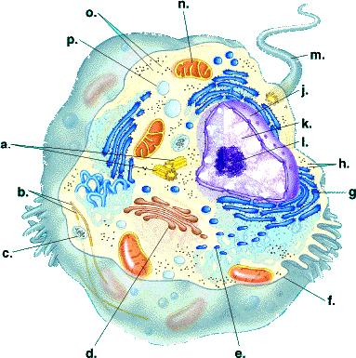

Slide 3
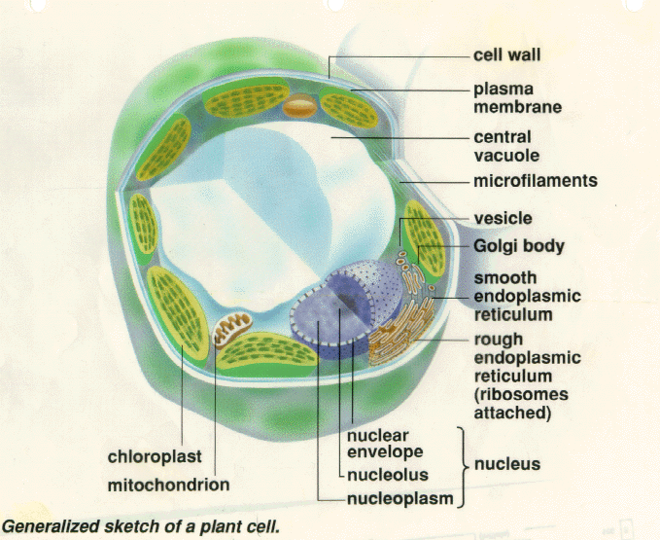

Slide 4
Cell Wall
Found in plants,
Animals do not have cell walls
Cell was is a rigid structure that surrounds a plant cell
Supports and protect the structure (cell)

Slide 5
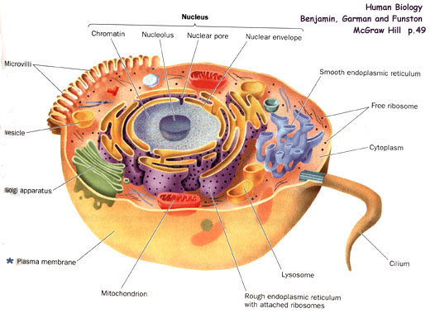

Slide 6
Cell Membrane
A protective barrier that encloses a cell
Cell membrane encloses, protects, and controls movement in and out of the cell

Slide 7
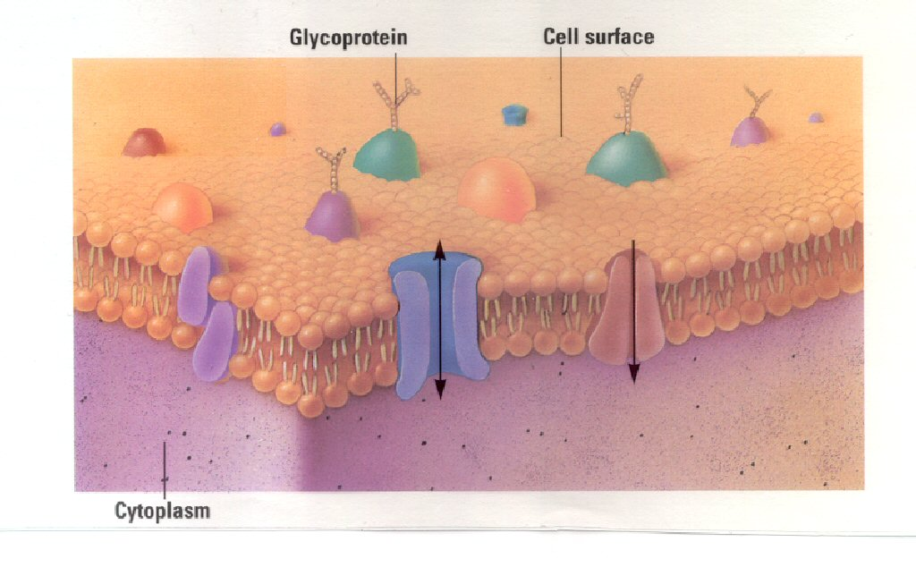
Magnification of Cell Membrane

Slide 8
Cytoplasm
A gel like material that fills the cell
Hold the cell parts in place

Slide 9
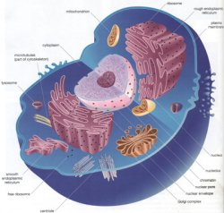
Nucleus

Slide 10
Nucleus
Large organelle that contains the cell’s DNA
Controls many functions of cell. Often considered the cell’s brain, contains DNA.

Slide 11
Ribosomes
Small organelles that make protein, lipids, and help break down toxins.

Slide 12
Endoplasmic Reticulum
System of folded membranes in which proteins, lipids, and other materials are made, processed, and transported.
ER transports materials. It also breaks down toxic material that could harm the cell

Slide 13
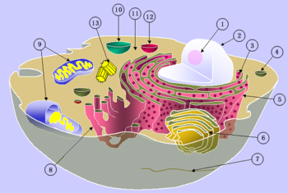
Rough ER

Slide 14
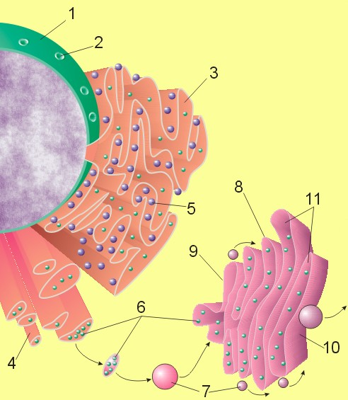
Rough ER

Slide 15
Mitochondria

Slide 16
Mitochondria
Organelle where sugar is broken down to produce energy.
Main power source of the cell that produces energy.

Slide 17
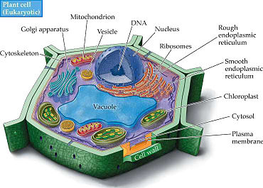
Chloroplast

Slide 18
Chloroplasts
Found in plants
Organelle in plant cells where photosynthesis occurs
Converts sunlight to energy

Slide 19
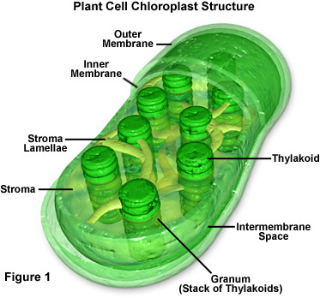
Chloroplast

Slide 20
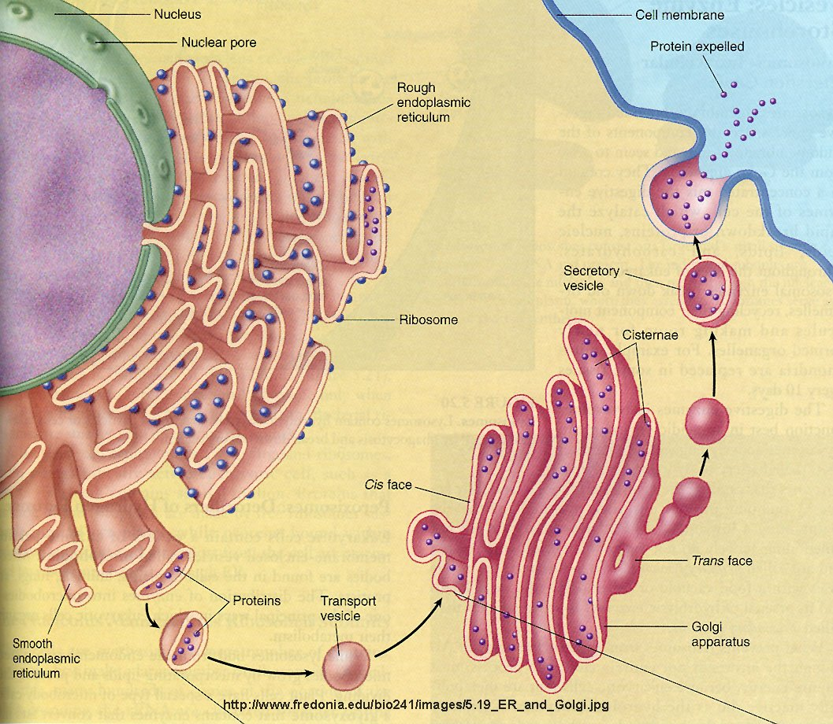
Golgi Apparatus/ Bodies

Slide 21
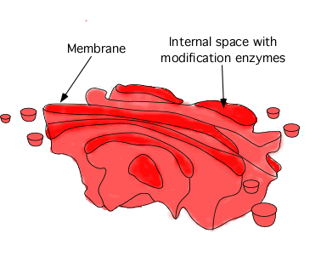
Golgi Apparatus
Flat, layered organelle
Packages and distributes proteins out of the cell.

Slide 22
Lysosomes
Organelles surrounded by membrane with digestive enzymes
Digests food, gets rid of waste, protects from outside invaders.

Slide 23
Plant Cell vs. Animal Cell

Slide 24
Plant Cell vs. Animal Cell
Make a Venn Diagram to compare and contrast plant and animal cells:
Plant cell
Animal cell
Both

