Slide 1
Cellular Transport

Slide 2
Active and Passive Transport
It is important for cells to control what enters and exits the cell.
There are two main types of cell transport:
Passive transport- does not require energy
Active transport- requires energy in the form of ATP

Slide 3
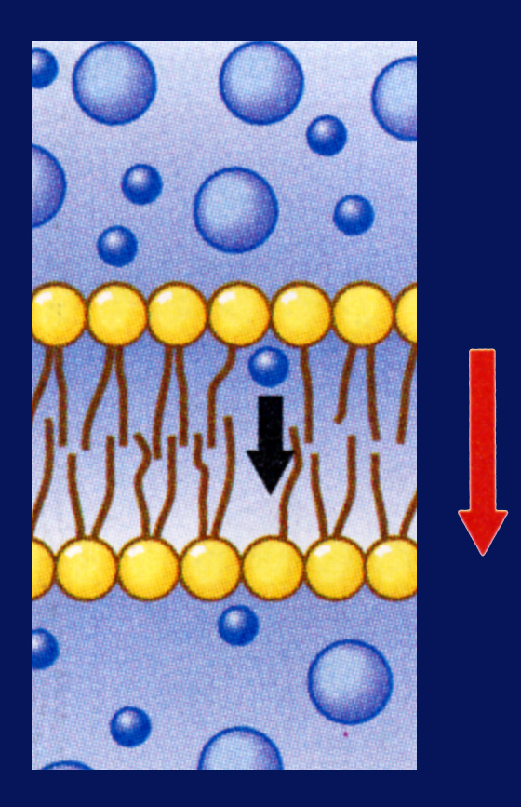
Passive Transport
When a cell uses no energy to move particles across a membrane passive transport occurs.
Particles go DOWN their concentration gradient.
Diffusion & osmosis are passive transport.
Plasma membrane
Concentration gradient

Slide 4
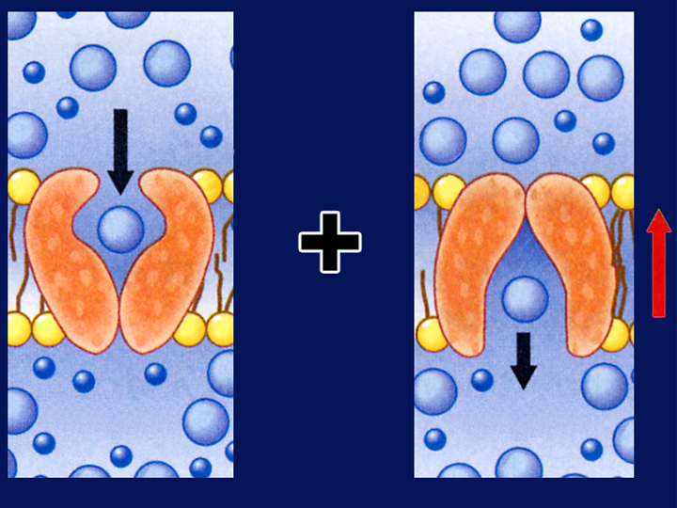
Active Transport
Active transport :Movement of materials through a membrane.
It goes against a concentration gradient and requires energy from the cell.
Plasma membrane
Concentration gradient

Slide 5
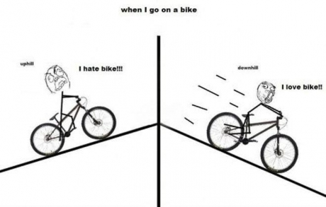
How can I remember this?
Passive Transport
because you don’t need to use any energy to go down the hill…just relax!
Active Transport because you use energy to go up the hill by pedaling.

Slide 6
Types of Active Transport
Endocytosis is a process by which a cell surrounds and takes in material from its environment.
Exocytosis is the expulsion or secretion of materials from a cell.

Slide 7
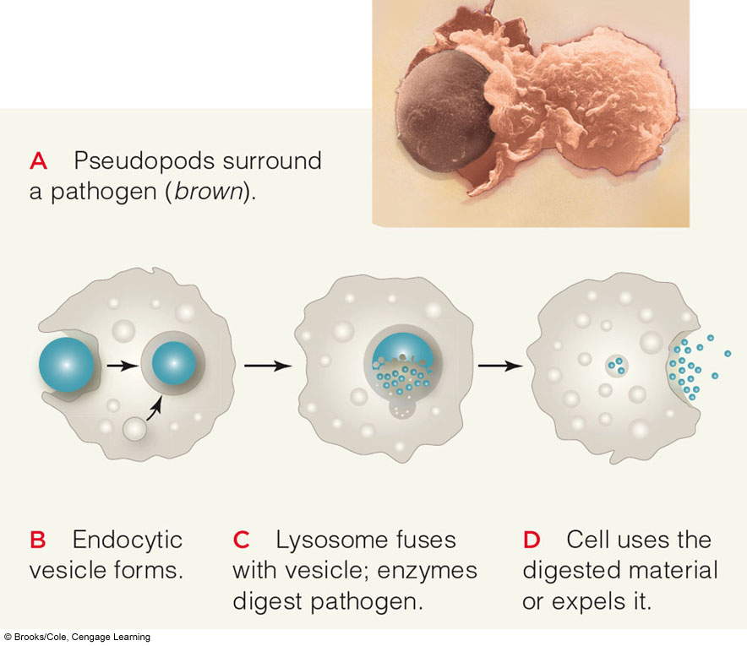
Endocytosis

