Slide 1
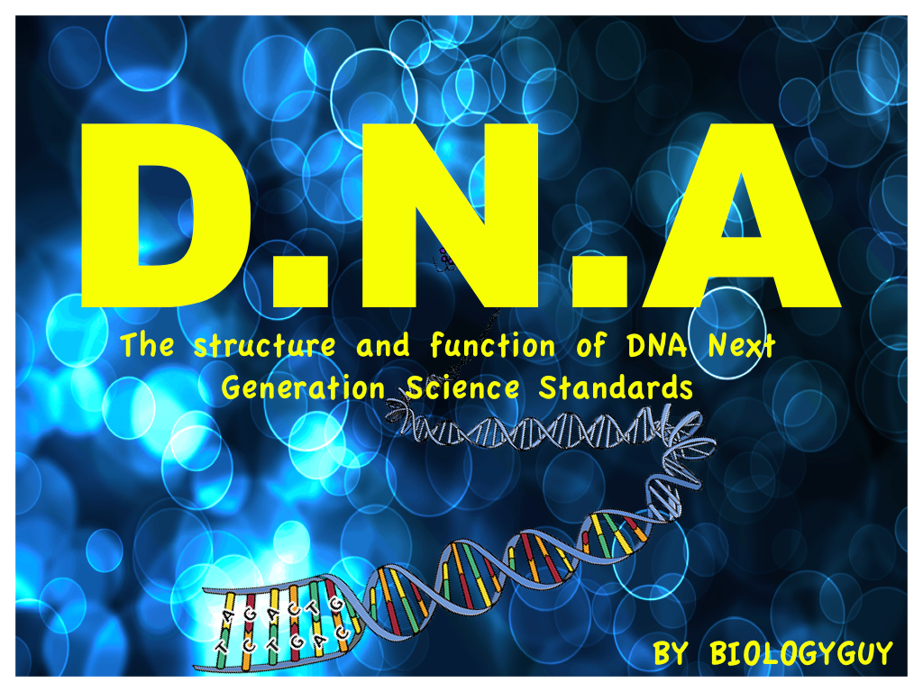

Slide 2
Let Review!
You will not need to add this stuff to your notes! Wait until you see a slide that says start! ☺

Slide 3
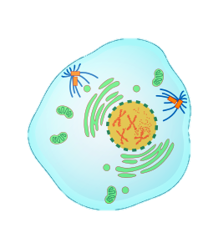


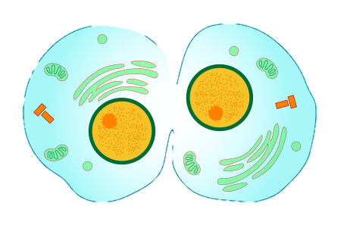


Mitosis:
When we grow we are basically getting more cells. These cells are made by mitosis.
Parent Cell
2 daughter cells
This picture shows
Cells undergoing
Different stages of
Mitosis.
BiologyGuy©

Slide 4
Mitosis:
PROPHASE
Parent Cell
METAPHASE
CYTOKINESIS
Here are the basic steps in Mitosis. The process starts with a parent cell and produces 2 daughter cells.
ANAPHASE
TELOPHASE
BiologyGuy©
BiologyGuy©

Slide 5
What Is Found In a Cell?
2
Cells are made up of many structures, many of these will be covered in another unit on cells. What we need to focus on is the NUCLEUS.
CYTOPLASM:
Gel like fluid, inside the cell, allows movement of organelles
RIBOSOME:
Site where proteins are made
NUCLEUS
Contains DNA, controls cells activity
CELL MEMBRANE
Surrounds the cell. Controls what enters and leaves the cell.
BiologyGuy©

Slide 6
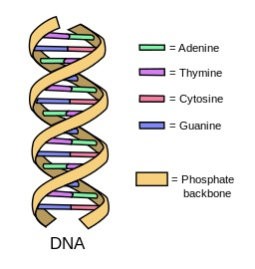
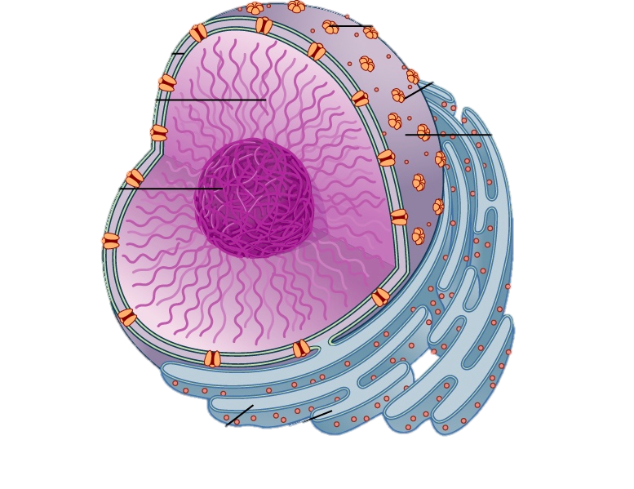
The Nucleus
The nucleus contains the very important genetic information, called DNA - Deoxyribonucleic Acid. The DNA, contains all of the information to build another cell, you could even build another person with the information that is found in a person’s DNA.
Nuclear envelope
Nuclear
pores
chromatin
nucleus
nucleolus
DNA
Cisternae
BiologyGuy©

Slide 7
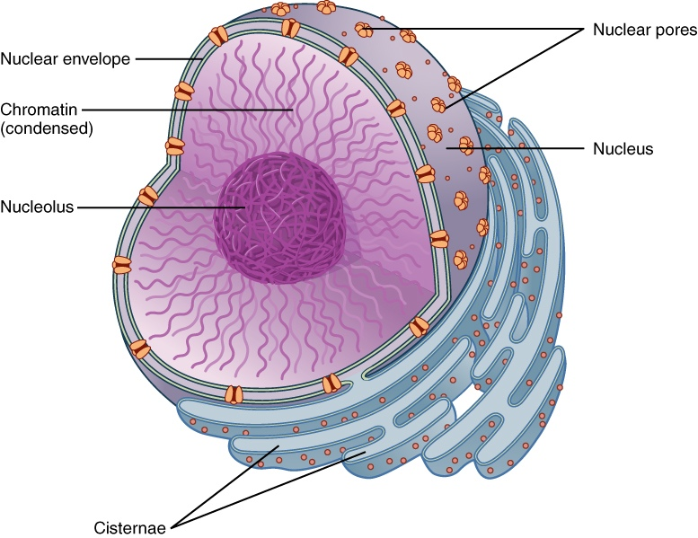
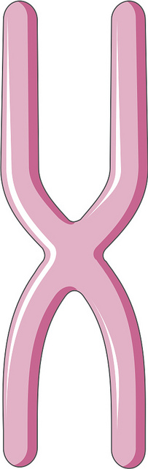
The Nucleus
In humans the nucleus contains chromosomes, there are 23 pairs of chromosomes, making 46 in total. Each paired chromosome has 2 variants of a gene. Genes are made of DNA. The genes code for our characteristics, such as eye color, hair type, they may even determine personality.
NUCLEUS
DNA
CHROMOSOME
DNA
BiologyGuy©

Slide 8
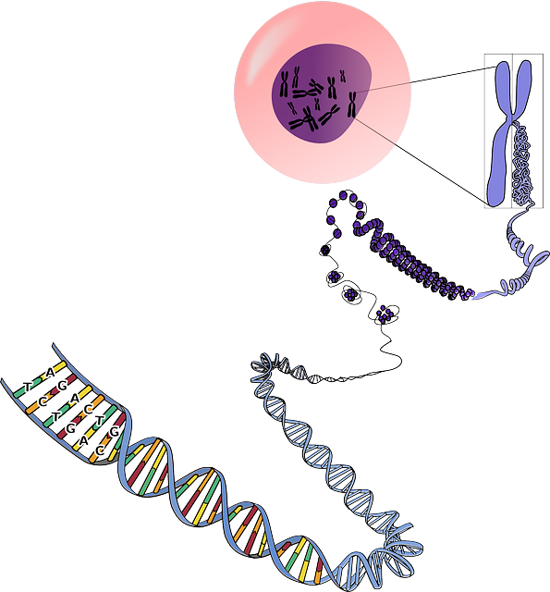
How are DNA, Genes and Chromosomes linked?
nucleus
chromosome
Cell
The cell contains the nucleus
The nucleus contains
chromosomes
Chromosomes are made of
genes
Genes are made of DNA
Gene
DNA
BiologyGuy©

Slide 9
And now for your actual notes!
Start!!

Slide 10
3.
The Structure of DNA?
DNA is constructed of 4 nucleotide bases, Adenine, thymine, cytosine, guanine.
These bases are held together by the sugar phosphate backbone, which is twisted.
The structure forms a double helix twisted ladder.
BiologyGuy©

Slide 11
The Structure of DNA?
Adenine
Thymine
Cytosine
Guanine
Thymine
Adenine
Guanine
Cytosine
Each DNA base pairs with its complimentary base. A-T, and G-C
BiologyGuy©

Slide 12
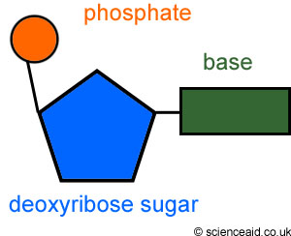
The structure of DNA
DNA is made up of subunits which scientists called ___________________.
Each nucleotide is made up of a __________, a ____________ and a ______________.

Slide 13
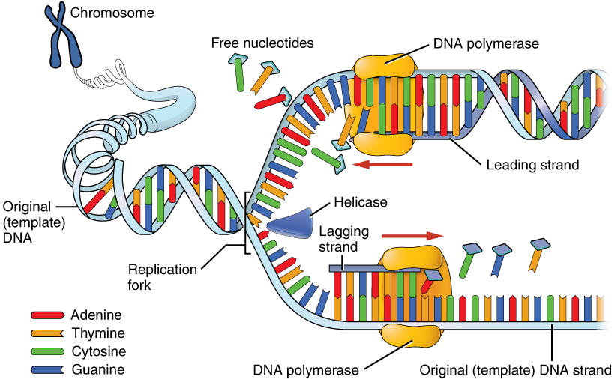
5
DNA Replication
BiologyGuy©

Slide 14
5
How is DNA replicated during growth?
When an organism grows its cells divide by MITOSIS. During this process the DNA needs to be copied and transferred to the new daughter cell. The process of DNA replication can be broken down into 3 steps.
Parent
DNA
DNA for daughter cells
BiologyGuy©

Slide 15
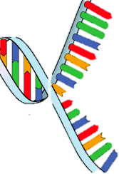
How is DNA replicated?
STEP 1
In order for DNA to replicate itself it needs to make a copy of its DNA. The 1st step in DNA replication is the unwinding of the DNA strand.
As the DNA unwinds it exposes the base pairs:
- Adenine
- Thymine
- Cytosine
- Guanine
DNA unwinds or
unzips
DNA
BiologyGuy©

Slide 16
How is DNA replicated?
STEP 2
In the 2nd step the DNA that is unzipped then creates a complimentary DNA strands using the existing DNA as a template. DNA polymerase creates the new strand by adding complimentary nucleotide bases to the the template strand.
TEMPLATE:
G A C T G A C T G A C
Template STRAND
DNA polymerase
C
Complimentary STRAND
G
T
Complimentary bases
BiologyGuy©

Slide 17
How is DNA replicated?
STEP 3
In the 3rd step the DNA Polymerase has successfully created the new strands, that match the bases in the original strand. The DNA then zips itself up. The cell now has a copy of its DNA and is ready to divide to produce a new cell, and start mitosis!
Original Template strand
TEMPLATE STRAND
G A C T G A C T G A C
C T G A C T G A C T G
NEW STRAND
DNA zips up
This DNA is identical to the original parent DNA.
New strand
The cell now has a copy of its DNA and is ready to divide by mitosis to produce a new cell.
BiologyGuy©

Slide 18
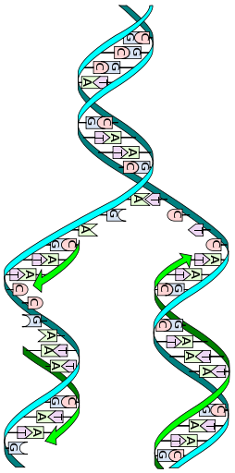
Summary of How DNA is replicated for growth:
Step 1. The DNA is unzipped
Step 2: DNA polymerase is used to create a complimentary strand to the original strand.
Step 3: The complementary strand and original strand zip together, forming DNA that is identical to the parent DNA
Parent DNA
1
2
The daughter DNA contains one new strand (complementary strand) and one old strand which came from the parent
Daughter DNA
3
BiologyGuy©

Slide 19
Okay you are done with todays notes, pay attention to the remaining so we can do a fun activity.

Slide 20
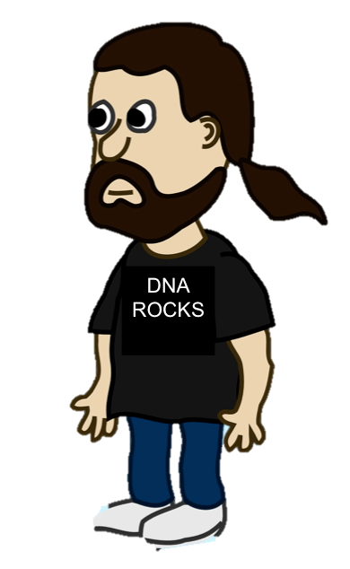
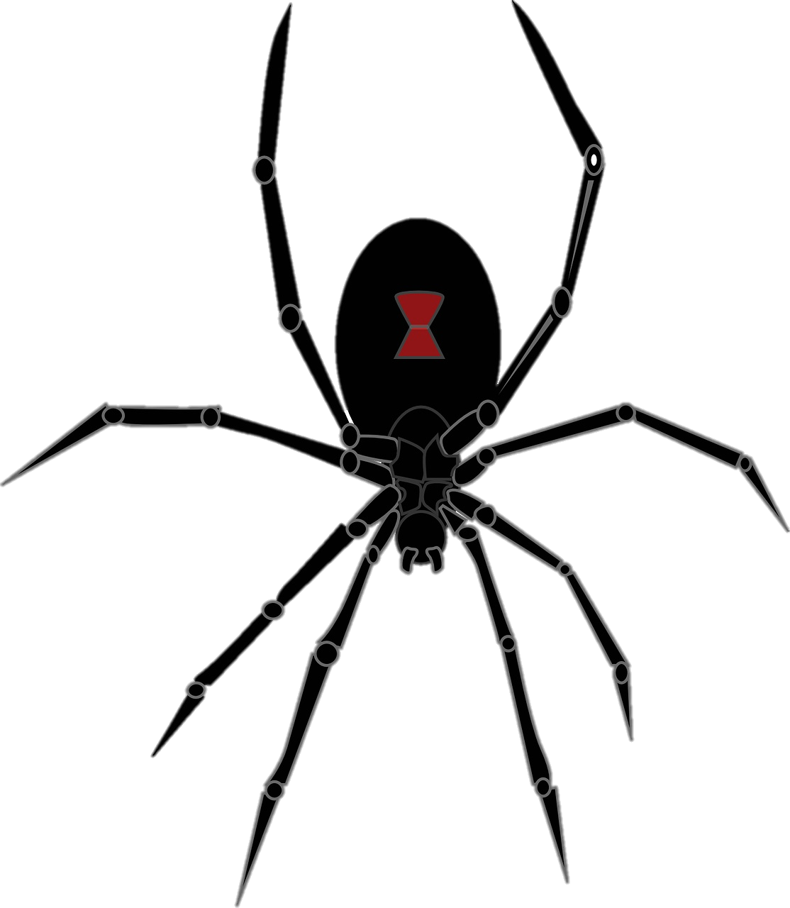
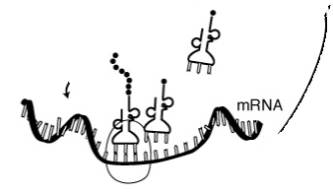
7
WHAT ARE MUTATIONS?
How did Peter Parker’s DNA change to give him spider ability?
The spider that bit him changed/mutated his DNA. The DNA then coded for different proteins, this made him have super powers
Can you guess who I am?
Super
protein
Mutation= change in DNA base
Spider mutation
BiologyGuy©

Slide 21
MUTATIONS
Can you guess who I am?
Who is this? What are his special powers?
Imagine if you had super powers and could shoot fire from your eyes. That would be an eXtreme mutation.
BiologyGuy©

Slide 22
Mutations
Why do super heroes have super powers?
Normal vision
T- T - T-C-C-G- G -G -C
Cyclops Vision ( With burst of light)
T- T- T- C- C- C -G- G- C
A Combination of mutations that occur in DNA sequences
will alter a gene. This altered gene will result in the production of different proteins which could give special abilities.
BiologyGuy©

Slide 23
Mutations
1. What mutation occurred in the DNA? What is the correct base pair of Thymine?
2. Will the normal DNA, produce the same Amino Acid and protein
As the mutated DNA?
BiologyGuy©

Slide 24
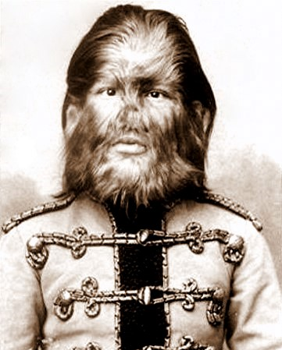
Human Mutations
This is a picture of Fedor Jeftichew, from Russia. He lived 1868 - January 31, 1904. He was a sideshow performer.
He was diagnosed with Hypertrichosis.
Hypertrichosis is also called “werewolf syndrome” or Ambras syndrome, and it affects as few as one in a billion people; and in fact, only 50 cases have been documented since the Middle Ages.
People with hypertrichosis have excessive hair on the shoulders, face, and ears. Studies have implicated it to a rearrangement of chromosome 8.
BiologyGuy©

Slide 25
Human Mutations
People with hypertrichosis have excessive hair on their shoulders, face, and ears. Studies have implicated it to a rearrangement of chromosome 8.
Chromosome 8
BiologyGuy©

Slide 26
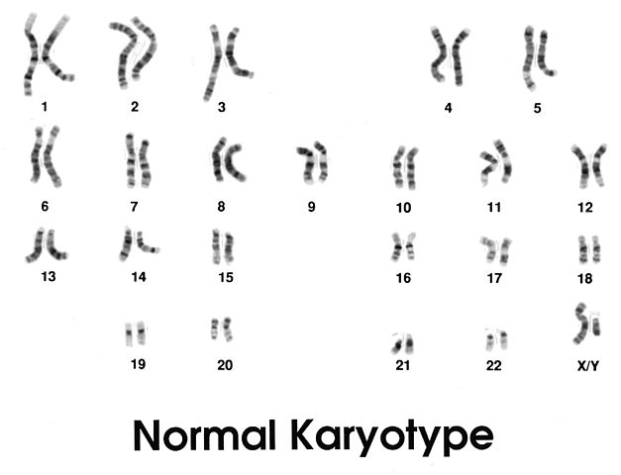
Human Mutations
Chromosome 8 can be seen in a human Karyotype, along with the other 22 pairs of chromosomes. In Hypertrichosis the DNA bases in chromosome 8 become rearranged.
Karyotype: an organized profile of an organisms’ chromosomes.
BiologyGuy©

Slide 27
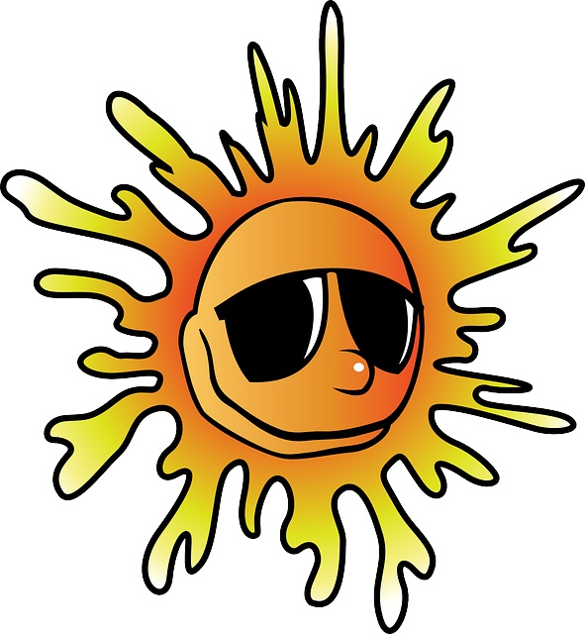
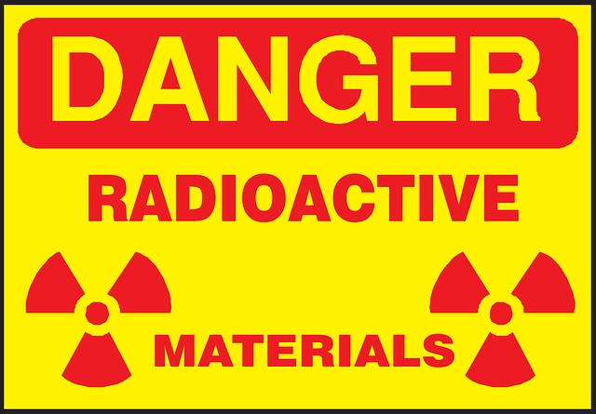
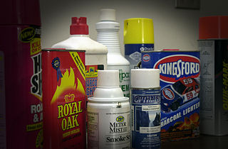
How Do Mutations Happen?
U.V Light from
the sun.
Radiation (nuclear)
Alpha, Beta, Gamma,
X-Rays.
Chemicals
like those found
in cigarettes and in the home.
Mistakes that
occur when a cell
copies itself.
BiologyGuy©

Slide 28
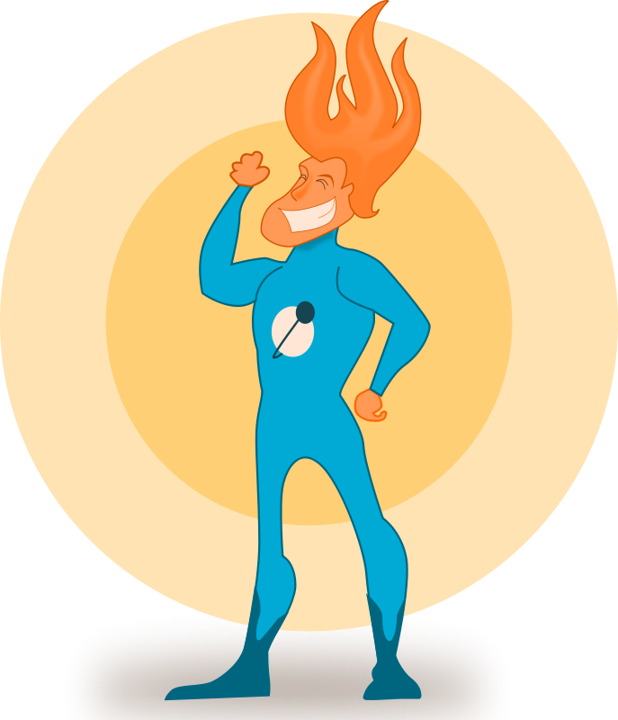
Do Mutations matter?
In the case of super heroes Mutations can be a good thing. They may even result in the survival of one species over another.
But they can be harmful, they can result in Cancers, or the expression of harmful traits. For example, a mutation that makes an animal a brighter color can make the animal easier for predators to find.
Sometimes the body’s cells produce proteins which repair mutations. But not all mutations are repaired. If it occurs in a sex cell these mutations could then be passed on to other generations.
BiologyGuy©

