Slide 1
Energy
Chapter 4 and 6

Slide 2
What is Energy?
You can experience it……
But you can’t directly see it…….
Nor can you directly hold it…….
But, you know it’s there!
In the 16th century, energy meant vigorous speech or writing, derived from the Greek and Latin words for “activity.”
Over time, energy was associated with power, activity and energize….

Slide 3
What is Energy?
ENERGY IS DEFINED as “the ability to do work, or cause change. ”
Recall: Work is done when a force moves an object through a distance……
There is a direct connection between work and energy; energy is therefore measured in the same unit as work --> joule ( J ).
If work is done on an object,
energy is given to the object.

Slide 4
Energizer – 2/4/13
Potential or Kinetic?
A cat poised to pounce on a toy.
A dam holding back water.
A flower pot falling from a high shelf.
While skiing you pause for a moment at the top of a steep hill, a few seconds later you begin to race down the mountain.

Slide 5

Kinds of Energy
Kinetic Energy
Energy of Motion
Depends upon mass and velocity
KE= ½ x mass x velocity²

Slide 6
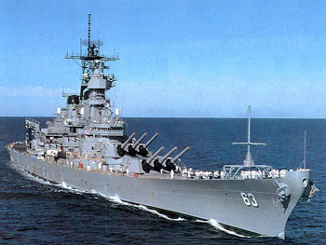
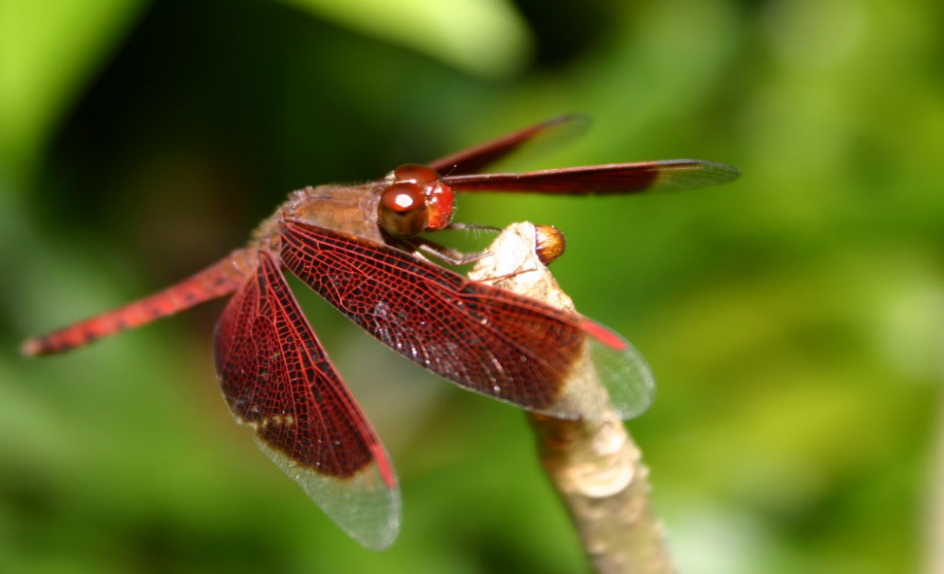
An object in motion has the ability to do work, therefore it has energy.
A battleship has much more kinetic energy . . .
than a dragonfly moving at the same velocity.

Slide 7


Potential Energy
The energy of position, or stored energy.
Objects that can do work because of their position or shape are said to have potential energy.
An object with potential energy is not moving or doing work. The object is storing the energy that was given to it when work was done on it.
It has the ability to give that energy back by doing work.
An archer gives potential energy to a bow by pulling it back.
The bow is storing the energy until it does work on the arrow!

Slide 8
Potential Energy includes an object’s potential for creating motion, so an object that is in a position that could lead to motion has Potential energy.
Recall the archer: The bow in the pulled back postion has the ability to cause motion; this is an example of elastic potential energy.
An object that is elevated has “gravitational potential energy.
G.P.E. = weight X height
Ex: a hiker would gain more G.P.E. by climbing to a greater height or by increasing weight, maybe by wearing a backpack.

Slide 9
FORMS OF ENERGY
The SIX main forms of energy are:
Mechanical (includes sound)
Heat (Thermal)
Chemical
Electromagnetic (includes Light)
Nuclear
Electrical

Slide 10
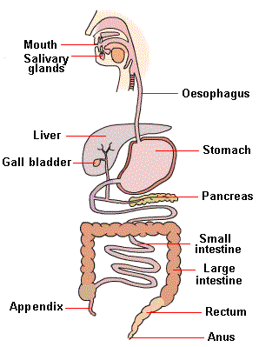
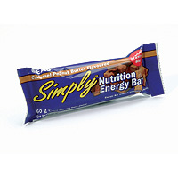
The food you may eat is
potential energy
Chemical energy stored in food is an example of potential energy;
the energy is released when the food is broken down during digestion and respiration.

Slide 11
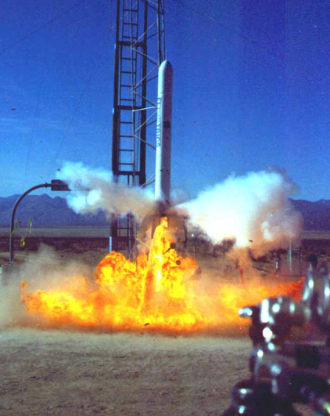
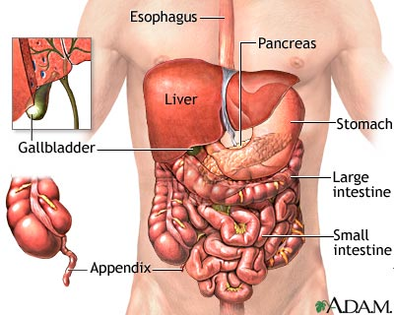
CHEMICAL ENERGY . . . . . . .
. . . . is the energy required to bond atoms together.
. . . . . when these bonds are broken, chemical energy is released.
Ex #1: firing of a rocket
engine --> the fuel (chemical energy) is burned (converted
into heat energy)
Ex #2: digesting of food (bonds are broken to release energy for your body to store
and use)

Slide 12
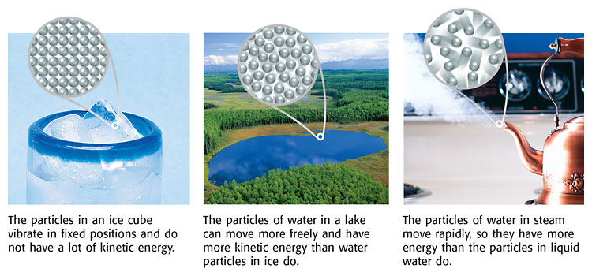
HEAT or Thermal ENERGY . . . . . .
. . . . . results from friction.
. . . results from the internal motion of atoms.
The faster the atomic particles move, the more heat energy is produced.

Slide 13
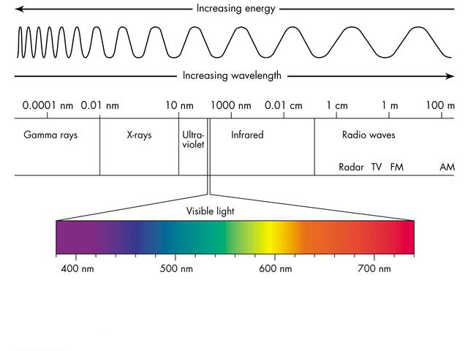
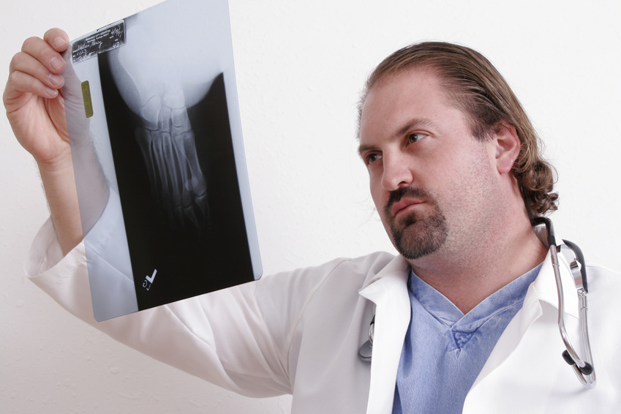
Electromagnetic, Radiant or Light Energy . . . . . .
Produced by vibrating electrical charges
. . . . . different colors represent different amounts of light energy.
. . . Light energy is also called electromagnetic energy. It is also carried by X-rays, radio waves, and laser light.

Slide 14
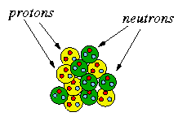
NUCLEAR ENERGY. . . . . .
. . . . . source --> at the center
of an atom (nucleus).
When the nucleus splits, nuclear energy is released in the form of heat energy and light energy.
The sun's energy is produced from a nuclear fusion reaction in which hydrogen nuclei fuse to form helium nuclei.

Slide 15

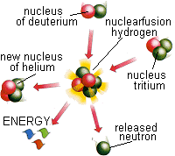
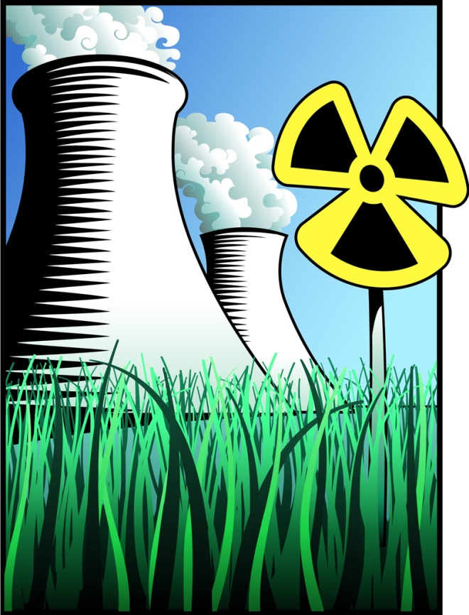
Nuclear is the most concentrated form of energy.

Slide 16
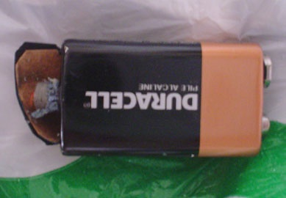
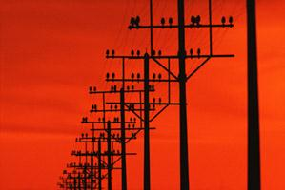
ELECTRICAL ENERGY. . . . . . .
. . . . is the energy and electric charges produced from
electricity.
Source --> batteries
or power lines.

Slide 17

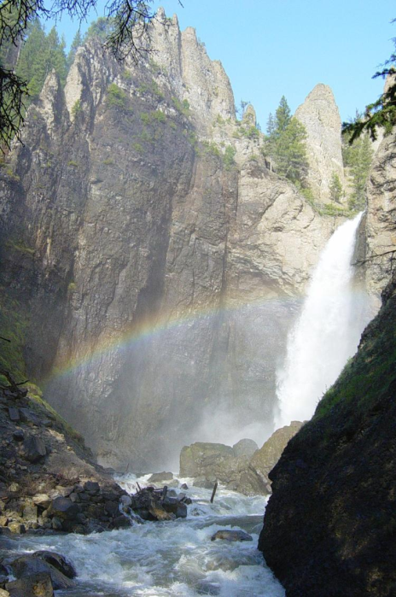
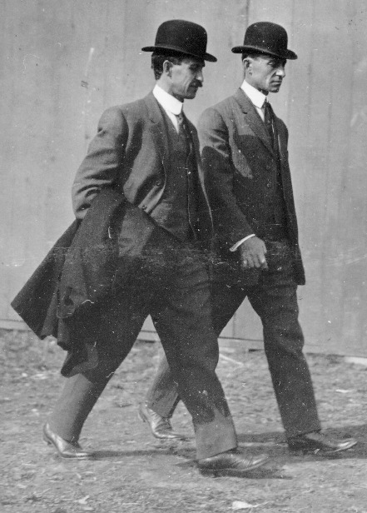
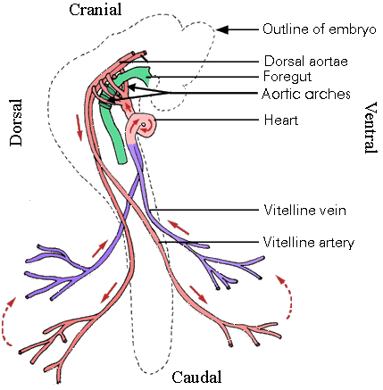
MECHANICAL ENERGY . . . .
. . . . is associated with motion.
Examples include:
automobile traveling
blood flowing through your blood vessels
a waterfall
walking

Slide 18

Sound (Mechanical) Energy
Caused by particle vibrations
As particles vibrate the vibration is passed through the air to your ear

Slide 19

Energy Conversion
B
A
A change from one form of energy to another
Any form of energy can change into any other form of energy

Slide 20
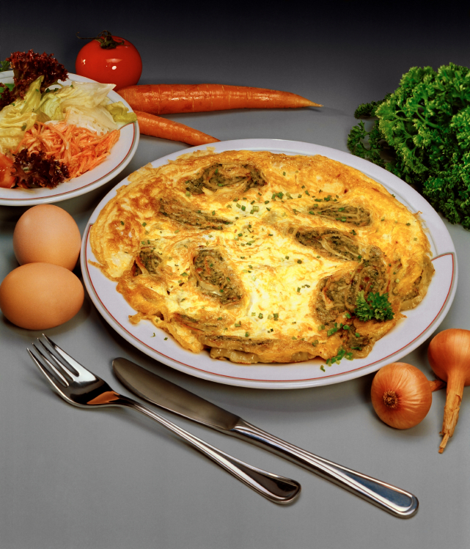
Conversions involving CHEMICAL energy…
Have you heard the saying “breakfast is the most important meal of the day?”
  Well it is true!
As your body digests your breakfast it breaks down the bonds within the food to release chemical energy. This energy is then transformed into all types to help you get through the day.

Slide 21

Where does chemical energy come from?
The Sun!!
Light energy from the sun is taken in by the plants on earth.
Through photosynthesis plants then convert this light energy into chemical energy.
This energy is then released as kinetic energy within you if you eat the plant. It can also be released as thermal and light energy if you light a fire using firewood.

Slide 22
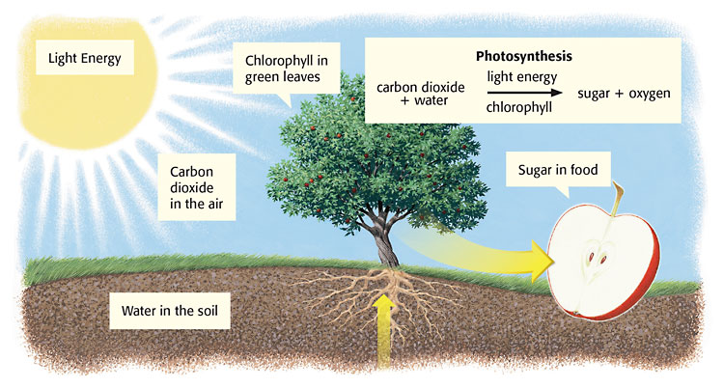
Where does all of the energy go??

Slide 23
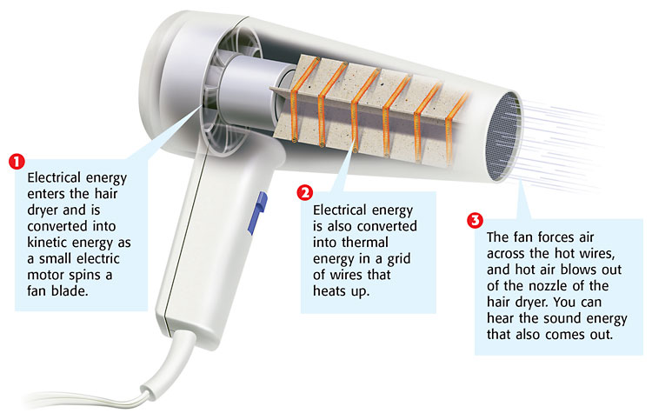
Where does all of the energy go??

Slide 24
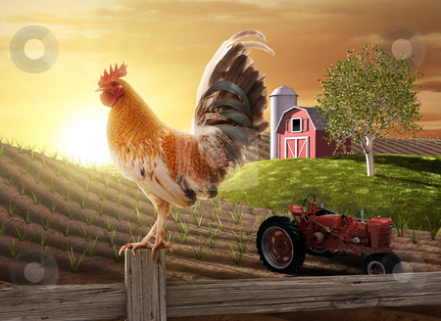
Label the energy conversions…

Slide 25
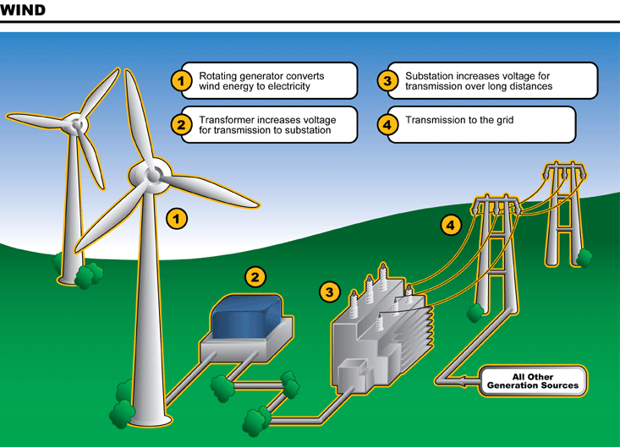

Slide 26
Temperature and Thermal Energy
What’s the difference?
Temperature IS NOT HOW HOT OR COLD SOMETHING IS!
Temperature is defined as the measure of the average kinetic energy of the individual particles in an object/substance.
  What is kinetic energy?
  What does average mean?

Slide 27

Temperature
The higher the average KE, the higher the temperature
Which substance has a lower temperature?

Slide 28
Temperature and Thermal Energy
What’s the difference?
Thermal energy is defined as the total energy of all the particles in an object/substance.
  What differences do you see in these definitions?

Slide 29
Temperature and Thermal Energy
TEMPERATURE IS a measure of the average kinetic energy of the molecules in a substance.
Thermal energy is defined as the total energy of all the particles in a substance
Adding thermal energy to a substance increases the average kinetic energy of the molecules and therefore causes a rise in temperature.
Higher temperature = faster molecular motion
Lower temperature = slower molecular motion

Slide 30
Temperature VS Thermal Energy
You have two containers with water at 90ºC
One container has a mass of 10 g, and the second has a mass of 5 g. ( there’s more substance in one container than another!)
They are at the same temperature, but the
10 gram sample has more thermal energy
TE depends upon mass, but temperature does not.

Slide 31
A Question to Consider…
The water in both of the beakers below is at a temperature of 30 degrees Celsius. Which has more thermal energy? Explain your answer.
B
A
100 mL
50 mL

Slide 32
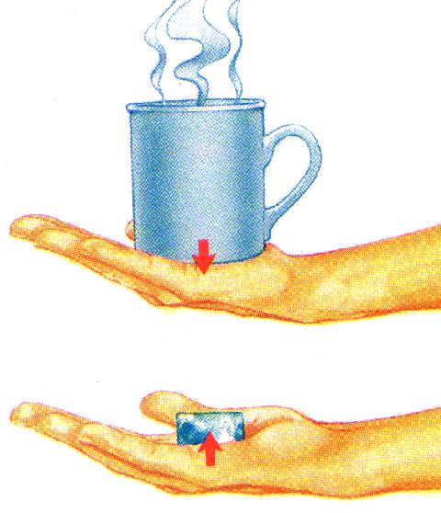
Heat
a. The flow of thermal energy from one object to another.
Cup gets cooler while hand gets warmer
b. Heat always flows from warmer to cooler objects.
Ice gets warmer while hand gets cooler

Slide 33
3 Types of Heat Transfer
Conduction
Convection
Radiation

Slide 34
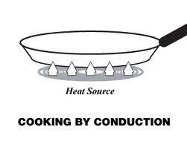
Conduction
Conduction heat transfer is the flowing of heat energy from a high-temperature object to a lower-temperature object.

Slide 35

Why does metal feel colder than wood, if they are both at the same temperature?
Metal is a conductor, wood is an insulator. Metal conducts the heat away from your hands. Wood does not conduct the heat away from your hands as well as the metal, so the wood feels warmer than the metal.

Slide 36
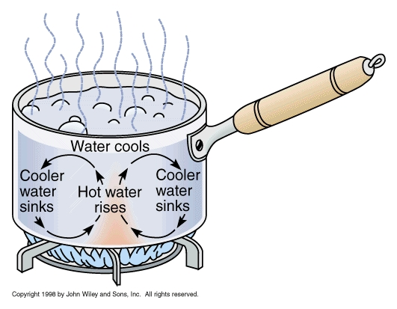
Convection
Movement caused within a fluid by the tendency of hotter and therefore less dense material to rise, and colder, denser material to sink under the influence of gravity
Motion in a gas (and air) or liquid in which the warmer portions rise and colder portions sink

Slide 37

Water movement
Cools at the surface
Convection current
Cooler water sinks
Hot water rises

Slide 38
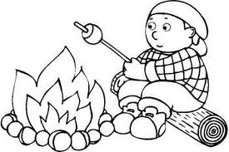
Radiation

Slide 39
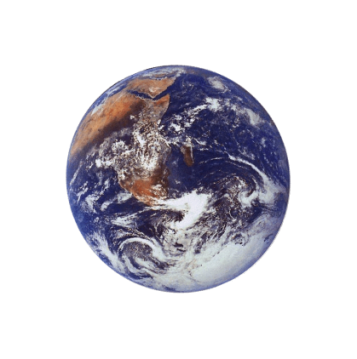
The third method of heat transfer
How does heat energy get from the Sun to the Earth?
There are no particles between the Sun and the Earth so it CANNOT travel by conduction or by convection.
RADIATION
?

Slide 40
Radiation
The transfer of energy by electromagnetic waves.
Examples:
Sun
Fire
Light bulb

Slide 41

Specific Heat
a. Some things heat up or cool down faster than others.
Land heats up and cools down faster than water

Slide 42
b. Specific heat is the amount of heat required to raise the temperature of 1 kg of a material by one degree (C or K).
1) C water = 4184 J / kg C
2) C sand = 664 J / kg C
This is why land heats up quickly during the day and cools quickly at night and why water takes longer.

Slide 43
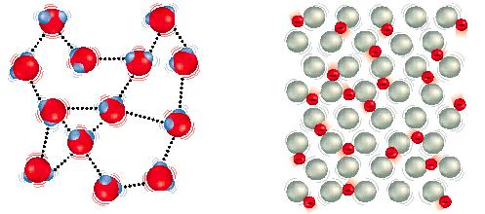
Why does water have such a high specific heat?
water metal
Water molecules form strong bonds with each other; therefore it takes more heat energy to break them. Metals have weak bonds and do not need as much energy to break them.

Slide 44
