Slide 1
Forces all around us

Slide 2
The Nature of Force
A force gives energy to an object, sometimes causing it to start moving, stop moving, or change direction.
A force can be a push or pull.
Newton: the unit used to express force (I pushed the chair with 50 N of force)
Net Force: the combination of all forces acting on an object
Notes:
Sec.1: The Nature of Force (page 312)
A force gives energy to an object, sometimes causing it to start moving, or changing direction.
A force can push or pull.
Forces can be balanced or unbalanced depending on the effect the force has on the motion of the object

Slide 3
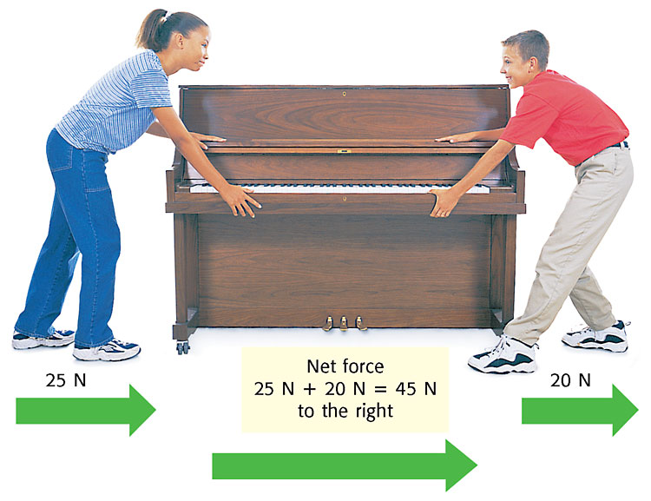
Forces Acting in the Same Direction
When multiple forces act upon an object in the same direction, you ADD the forces to find the net force acting on the object.

Slide 4
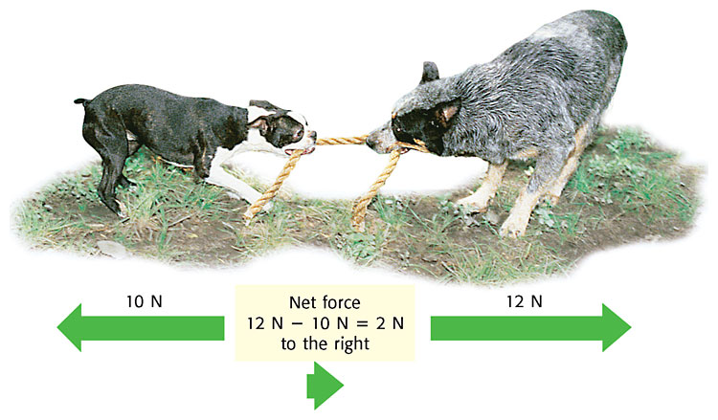
Forces Acting in Opposite Directions
When multiple forces act upon an object in the opposite directions, you SUBTRACT the forces to find the net force acting on the object.

Slide 5
Balanced Forces
Balanced forces cause NO CHANGE in motion
Forces that are in opposite directions and equal in size are called balanced forces.
When forces are balanced, there is no change in motion; there would be no overall force (net force) acting on the object.

Slide 6
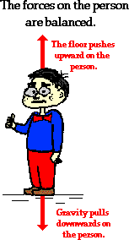
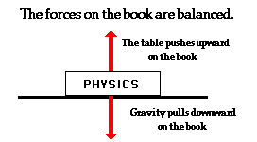
Balanced Forces

Slide 7
Unbalanced Forces
Unbalanced forces cause a CHANGE in motion
Same direction
When two forces are acting in the same direction, they are added together.
The size of the arrow is relative to the strength of the force.
This force is unbalanced because there is a change in motion

Slide 8
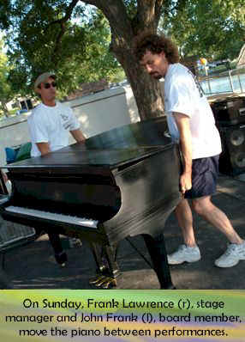
Unbalanced Forces Same Direction
They each provide an “applied force” in the same direction. Meanwhile, gravitational force and frictional forces are working against them.
Since Frank and John’s combined forces are greater, then the piano moves!
The net force is “unbalanced”
Frank and John are pushing the piano on its wheels to move it.

Slide 9
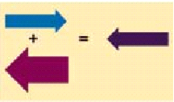
Unbalanced Forces-Opposite directions
When two forces act in opposite directions, they combine by subtraction,
If one force is greater than the other force, the object will move in the direction of the greater force (tug-of-war).
This force is unbalanced because there is a change in motion
Notes:
In opposite directions
When two forces act in opposite directions, they combine by subtraction, (cancel each other out).
If one force is greater than the other force, the object will move in the direction of the greater force (tug-of-war)..

Slide 10
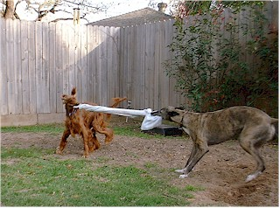
Unbalanced Forces
In this game of tug of war, the red dog is losing ground.
The applied force of the red dog is not as great as the applied force of the gray dog.
Net force is unbalanced, and in the direction of the gray dog.

Slide 11
Newton’s First Law
An object at rest remains at rest, and an object in motion remains in motion at a constant speed and in a straight line unless acted upon by an unbalanced force.

Slide 12
Part 1
An object at rest
An object at rest will not move until a push or a pull is exerted on it.
Ex. You must pull on a chair to get it to move out from under a table.

Slide 13
Part 2
An object in motion
In order to slow, speed up or change the direction of an object an unbalanced force must act upon it.

Slide 14
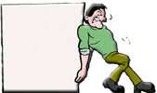
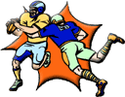
Inertia
The property of an object that resists changes in its state of rest or motion.
When stationary difficult to push.
When moving difficult to stop.

Slide 15
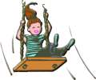
Inertia depends on mass.
Which would have more inertia?
A child on a swing or an adult on a swing?

Slide 16
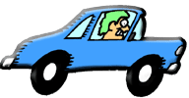
When you are in a car that is accelerating, you feel as if you are being pushed back. Your body (actually the inertia of your body) is resisting the increase in speed. When the car comes to a sudden stop, your body wants to continue in a forward motion.
· Sudden Starts - head rests stop the head from being pushed back. (rapid positive acceleration)
· Sudden Stops - seat belts help your body resist the tendency to keep moving. (rapid negative acceleration)

Slide 17
ENERGIZER
A physics teacher walks 4 meters East, 2 meters South, 4 meters West, and finally 2 meters North. What is the distance and displacement for this teacher?

Slide 18
What is gravity?
Sir Isaac Newton
1642 – 1727
The Principia
the greater the distance between two objects, the smaller the gravitational force
the force of gravity decreases by the amount equal to one divided by the distance (d) squared
1/d²
force of attraction between all objects in the universe
the larger an object’s mass, the greater the gravitational force

Slide 19
What is air resistance?
air resistance
force that opposes the movement of an object in air
a larger surface area usually results in greater air resistance
lighter objects feel more air resistance than heavier objects

Slide 20
Terminal Velocity
speed at which air resistance and gravity acting on an object are equal
as an object falls, it’s speed increases at a steady rate until it reaches it’s terminal velocity

Slide 21
Vacuum – empty space
in a vacuum, all objects fall at the same speed

Slide 22
What is friction?
Friction
force that opposes the motion of an object
the force of friction works in the opposite direction of the force of motion
friction makes motion possible
friction also makes it hard to move objects
reducing friction makes it easier to move objects

Slide 23
Types of Friction
Sliding Friction
the source of friction is the contact between two surfaces, at least one of which is in motion

Slide 24
Types of Friction
Air Resistance
friction results from air pushing on an object as it is moving

Slide 25
Types of Friction
Rolling Friction
friction between two surfaces that are not in constant contact
ex. wheels

Slide 26
How can friction be reduced?
by changing sliding friction into rolling friction
by using lubricants
Lubricants – substances that reduce friction

Slide 27
What is pressure?
Pressure
force per unit area
pressure is the amount of force acting on a surface
pressure equals force divided by area
p = f/a

