Slide 1
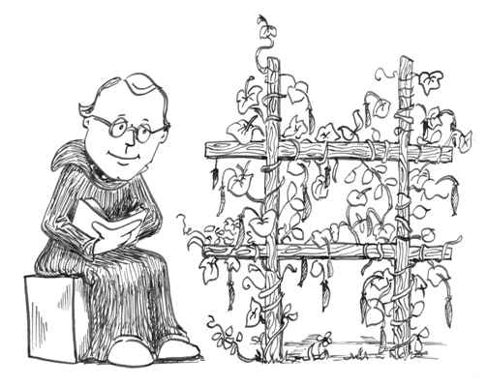
Mendel’s genetics

Slide 2
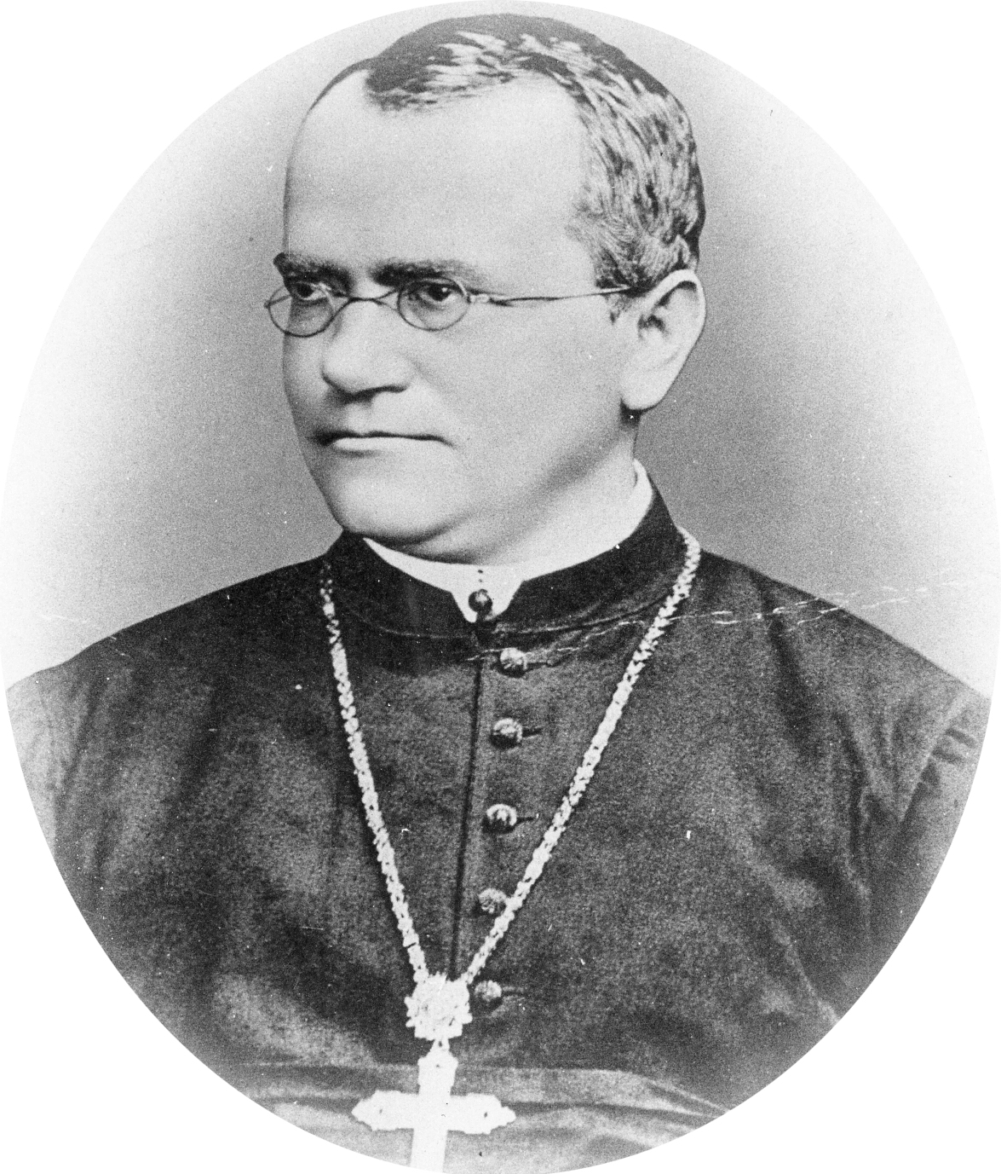
The Work of Gregor Mendel
The work of an Austrian monk named Gregor Mendel was especially important to understanding heredity
Heredity is the passing of traits from parents to offspring
Mendel lived and worked at a monastery – one of his jobs there was to tend to the monastery garden
In this ordinary garden, he was to do the work with ordinary garden peas that changed biology forever

Slide 3
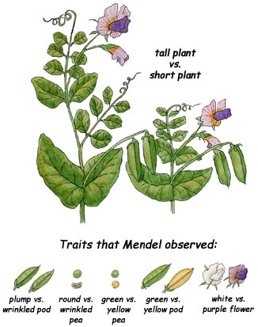
The Work of Gregor Mendel
Mendel knew that certain parts of a flower produce pollen (male gamete) while other parts produce egg cells (female gametes)
During sexual reproduction, the male and female gametes join (this is called fertilization) and produce a new cell (called a zygote)
In the case of the peas, this zygote was formed from the male and female parts on a single plant (called self-pollination)
Resulting in offspring that are the same as the parent

Slide 4
The Work of Gregor Mendel
Mendel’s experimentation started when he wondered what would happen if he combined the male and female gametes from TWO different plants
Fertilization between two different plants is called cross-pollination
He did this by brushing the pollen from one flower onto the flower of another plant
This made it possible for Mendel to cross-breed plants with different characteristics and then study the results

Slide 5
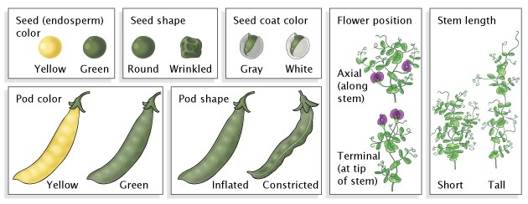
The Work of Gregor Mendel
Mendel studied several pea plant traits (A trait is a specific characteristic that can be inherited, such as seed color or plant height)
Each of the traits he studied had two contrasting forms of that trait, such as green seed color vs. yellow seed color
Mendel crossed plants with the two contrasting characteristics of each trait and studied the offspring

Slide 6
The Work of Gregor Mendel
In his crosses, he called the parent plants the “P Generation” and the offspring generation the “F1 Generation”
The F1 Generation are hybrids, since they are the offspring of crosses between parents with different traits
So what did this F1 generation of Mendel’s crosses look like? Did the traits of the parents blend in the offspring?
Not at all. To Mendel’s surprise, all of the offspring had the characteristic of only one of the parents
In each cross, the characteristics of the other parent seemed to disappear

Slide 7
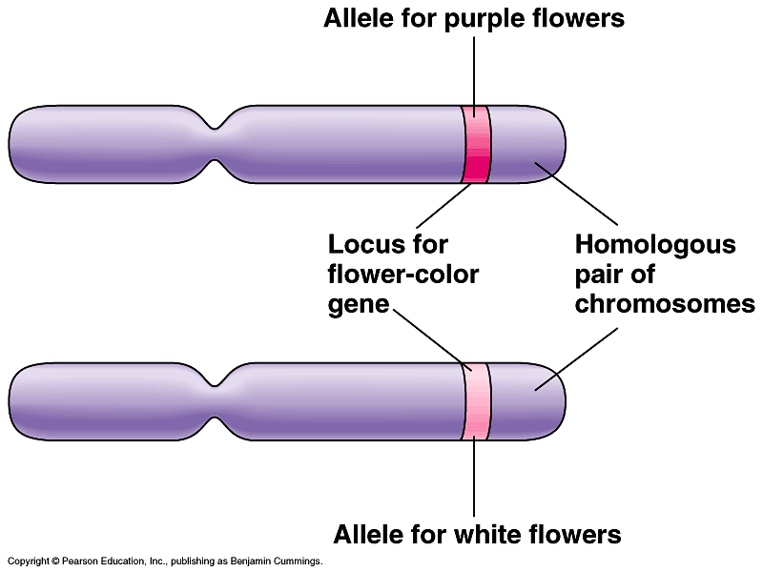
Genes and Dominance
From this set of experiments, Mendel drew two conclusions
There are factors that determine traits (now we know them as genes) and they are passed from parents to offspring
Each of the traits Mendel studied was controlled by one gene that occurred in two contrasting forms
The different forms of a gene are called alleles

Slide 8
Genes and Dominance
Some alleles are dominant and others are recessive (this is the Principle of Dominance)
An organism with a dominant allele will always physically show the dominant form of the trait
An organism with a recessive allele will physically show that form only when the dominant allele is NOT present
Mendel was able to determine which alleles were dominant based on which alleles the offspring of the cross showed

Slide 9
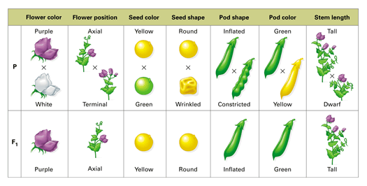
Genes and Dominance

Slide 10
Question
Example Problem:
In the pea plant, there is a gene that codes for seed color
The dominant allele of this gene is for yellow seeds
The recessive allele of this gene is for green seeds
If a plant with green seeds is crossed with a plant with yellow seeds, what color seeds will the offspring have?
Yellow seeds, since that is the dominant allele

Slide 11
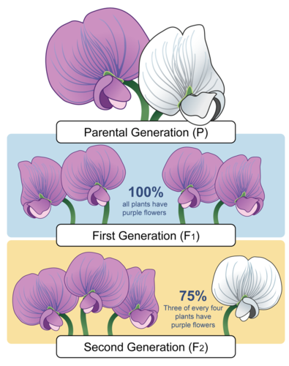
Genes and Dominance
Mendel had another question after he got these results: Had the recessive alleles disappeared, or were they still present in the F1 plants?
To answer this question, he allowed all the F1 hybrid plants to produce an F2 generation by self-pollination
In other words, he crossed the F1 generation with itself to produce the F2 offspring
Mendel discovered that the trait controlled by the recessive allele reappeared in the F2 generation

Slide 13
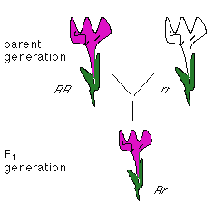
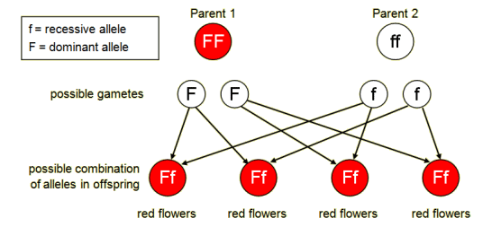
Genes and Dominance
The results of this F1 cross experiment led Mendel to develop the Law of Segregation
When each of the F1 plants flowers and produces gametes, the two alleles segregate from each other so that each gamete carries only a single copy of each gene
Diploid → Two alleles for a gene, but only one is expressed (physically seen)
Haploid → One allele
A dominant allele will be shown as a capital letter (A) while a recessive allele will be shown by a lower case letter (a)

Slide 14
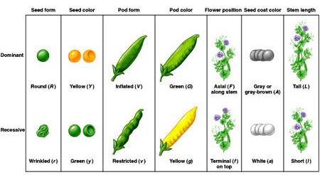

Slide 15
Question
Example Problem
If the dominant allele is always the one expressed…
And the gene for flower color has two alleles, P for purple and p for white…
A plant that has both the P and p alleles will have what color flowers?
Purple, because only the dominant trait is expressed!

Slide 16
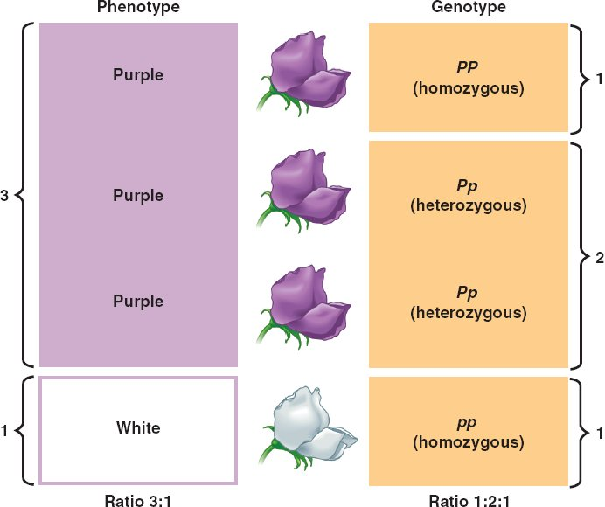
Genotype vs. Phenotype
An organism’s genotype is their genetic makeup, or what their alleles are
An organism’s phenotype is the traits that are expressed and therefore are physically visible
Heterozygous – different alleles (ex: Pp)
Homozygous – same alleles (ex: PP or pp)

