Slide 1
Mitosis and meiosis

Slide 2
Mitosis
The process where a single cell divides resulting in two identical cells, each containing the same number of chromosomes and genetic content as that of the original cell
Mitosis

Slide 3
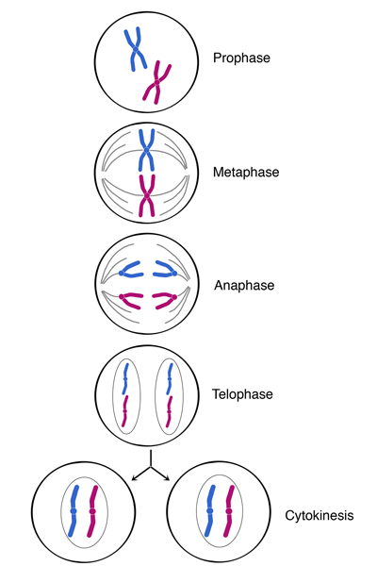
Phases of Mitosis
There are 4 main phases of Mitosis:
Prophase
Metaphase
Anaphase
Telophase

Slide 4
Meiosis
A process in cell division during which the number of chromosomes decreases to half the original number by two divisions of the nucleus, which results in the production of sex cells
Phases of Meiosis

Slide 5
Phases of Meiosis

Slide 6
Phases of Meiosis
There are 8 main phases of Meiosis
Prophase I
Metaphase I
Anaphase I
Telophase I
Prophase II
Metaphase II
Anaphase II
Telophase II

Slide 7
What type of cells are made?
Mitosis
Meiosis
The process of mitosis is the reproduction of somatic cells, or body cells.
Ex: hair cells, skin cells
The process of meiosis is the reproduction of sex cells
Ex: Egg and Sperm

Slide 8
Genetic Variation
Mitosis
Meiosis
Daughter cells are identical to their parent. The DNA and genetics are copied and reproduced to form new cells. The daughter cells have the exact 46 chromosomes as the parent cell.
The daughter cells are similar to the parents cells but not identical. Daughter cells only have 23 chromosomes because they must meet up with another sex cell to reproduce an offspring.

