Slide 1
Pedigree Charts
The family tree of genetics
Notes:
A quick refresher for the teacher on important terms:
Autosomal gene- a gene found on any chromosome except for the sex chromosome. These are chromosomes numbered 1-22.
X-linked gene- a gene found on a chromosome designated as a sex chromosome (X or Y).
Dominant- Refers to an allele that is expressed phenotypically and masks any recessive counterpart.
Recessive- An allele that is not phenotypically expressed when its counterpart is dominant.

Slide 2
What is a Pedigree?
A pedigree is a chart of the genetic history of family over several generations.
Scientists or a genetic counselor would find out about your family history and make this chart to analyze.
Notes:
A pedigree is a chart of the genetic history of family over several generations. Scientists or a genetic counselor would find out about your family history and make this chart to analyze it. For example, a couple might like to know their chances of having a child that has muscular dystrophy. So the scientists or a genetic counselor would find out who had muscular dystrophy in the mother’s and/or father’s families. This information would be used to and then calculate the probability of the couple having a child with MD.

Slide 3
Pedigree Symbols
Unaffected Female
Unaffected Male
Notes:
You must learn the symbols of the pedigree charts before you can start to learn how to interpret it. These are the symbols that represent a male and a female.

Slide 4
Pedigree Symbols
Affected (expressed)
Deceased (doesn’t necessarily mean the “trait” is what killed them)
Carriers
or
or
Notes:
These are examples of different types of symbols. These symbols would be the same for males or for females, except for X-linked carrier which is only used for females. So an affected male would be a square that is filled in completely. A deceased female would be a circle with a diagonal slash.

Slide 5
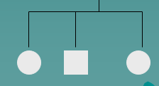
Pedigree Symbols
Examples of connected symbols:
Married Couple
Siblings
Notes:
These symbols also represent relationships between people. A horizontal line connecting two people shows that they are married or that they reproduced. A vertical Line connecting a married couple to people below them, means that they are offspring.

Slide 6
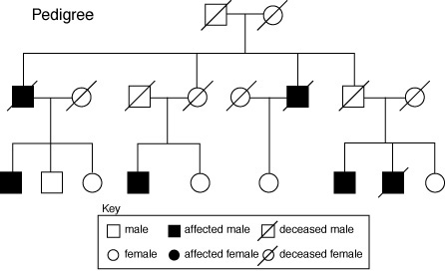
Pedigree Symbols
Each generation is shown as a roman numeral, and each person in that generation is numbered.
I
II
III

Slide 7
Interpreting a Pedigree Chart
Determine whether the disorder is dominant or recessive.
If the disorder is dominant, one of the parents must have the disorder.
If the disorder is recessive, neither parent has to have the disorder because they can be heterozygous.
Notes:
The second step is to determine if the disorder is dominant or recessive. It is important to find out if a disorder is dominant or recessive. For example, Huntington’s disease is a dominant disorder. If you have only one dominant gene you will have Huntington’s disease, which is a lethal disorder. The disorder does not show up until a person is in their middle ages such as 45. It will quickly decrease their motor skills and the brain will begin to deteriorate.
If a disorder is dominant, one parent must have the disorder (either homozygous dominant (TT) or heterozygous recessive (Tt). Both parents do not have to have the disorder. One parent might not have the disorder or be a carrier. If a disease is dominant, it does not skip a generation unless one parent is heterozygous dominant (Tt) and the other parent is homozygous recessive (tt). In this case the child has a chance of not receiving the dominant gene.
If the disorder is recessive, a parent does not have to have the disorder, but could still pass it to their offspring. This would happen when a parent is heterozygous recessive (Tt) and passes on the recessive (t) gene. This means this disorder can skip generations. An example of a recessive disorder would be sickle cell anemia.

Slide 8
Example of Pedigree Charts
Is the trait Dominant or Recessive?
Notes:
Is this pedigree dominant or recessive?

Slide 9
Answer
Dominant
Notes:
It is dominant because a parent in every generation have the disorder. Remember if a parent in every generation has the disorder, the disorder has not skipped a generation. If the disorder has not skipped a generation the disorder is dominant.

Slide 10
Example of Pedigree Charts
Dominant or Recessive?
Notes:
Is this pedigree dominant or recessive?

Slide 11
Answer
Recessive
Notes:
It is recessive because a parent in every generation does not have the disorder. Remember the disorder can skipped a generation if the disorder is recessive. The parents can be heterozygous and be carriers of the disorder but not have the symptoms of the disorder.

Slide 12
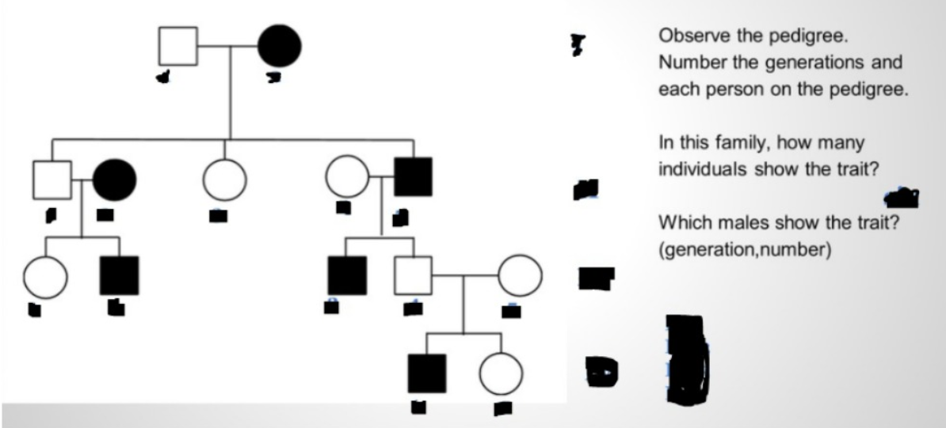

Slide 16
