Slide 1
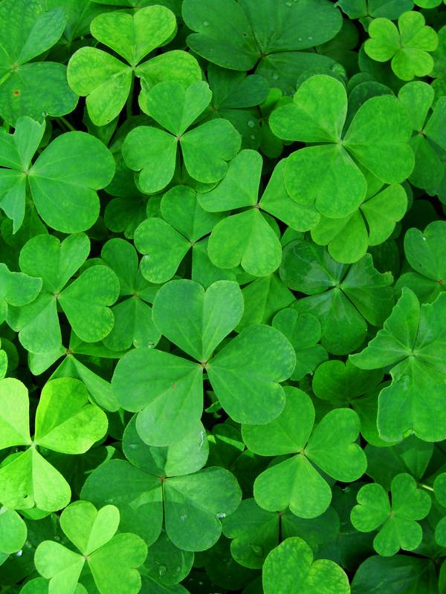
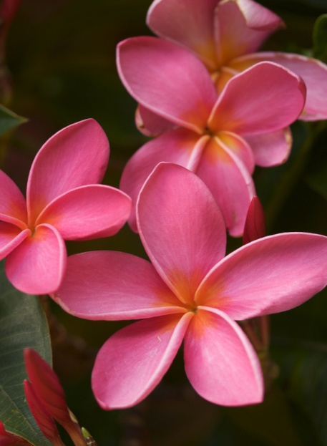
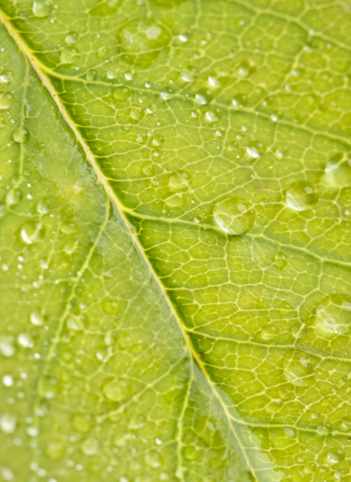
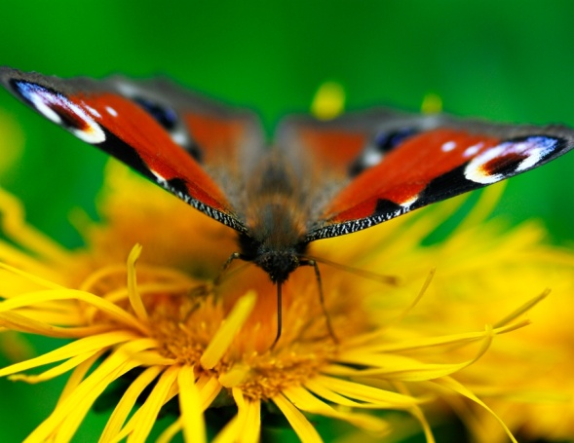
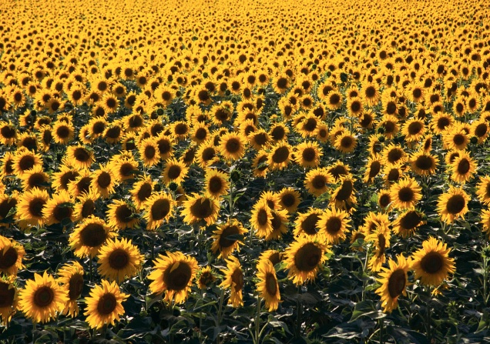
Photosynthesis
&
Cellular Respiration

Slide 2
Photosynthesis Vocabulary
Photosynthesis- A process by which plants convert sunlight, water, and carbon dioxide into food energy (sugar), oxygen and water.
Chloroplast- An elongated cell organelle containing chlorophyll where photosynthesis takes place.
Chlorophyll- A green molecule which uses light energy from sunlight to change water and carbon dioxide gas into sugar and oxygen

Slide 3
Photosynthesis Equation
H2O + CO2 + light → O2 + C₆H₁₂O₆
Water+ Carbon + sun → Oxygen + glucose
Dioxide (sugar)

Slide 4
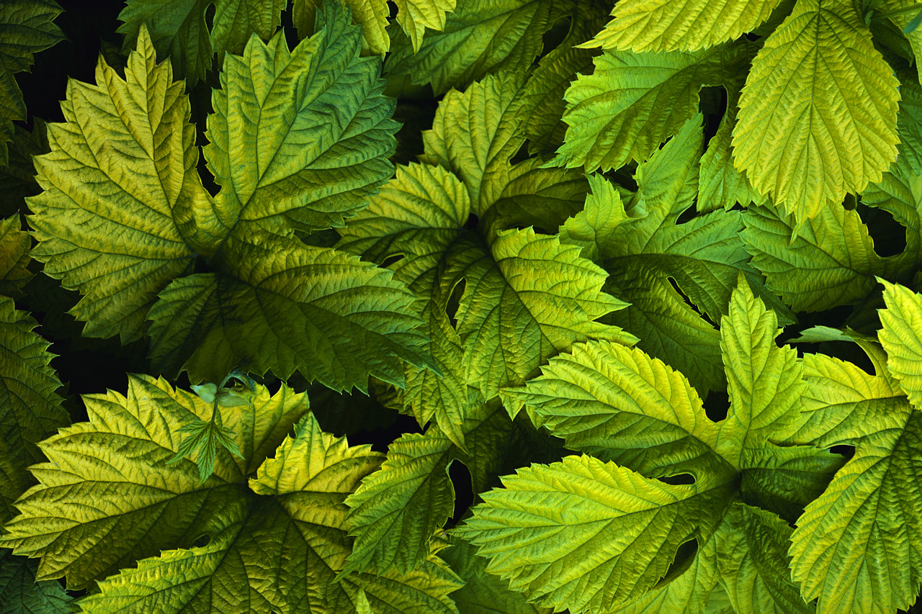
The chlorophyll absorbs the sunlight.
Chlorophyll is the green pigment inside the chloroplasts of plant cells that makes leaves green!

Slide 5
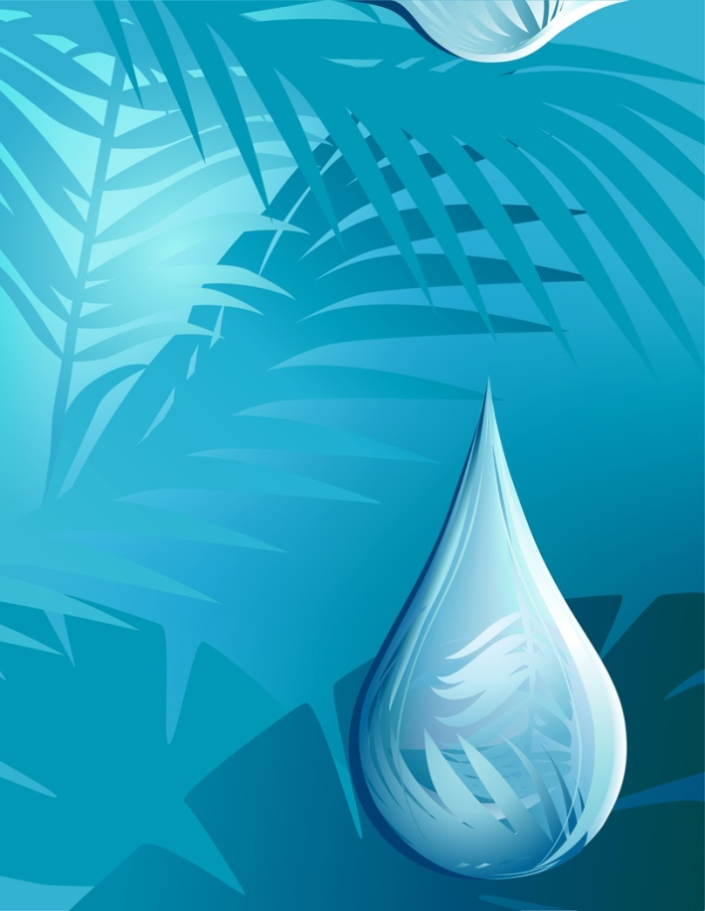
Chlorophyll then uses sunlight to change water, carbon dioxide and, nutrients from the soil.
CO2

Slide 6
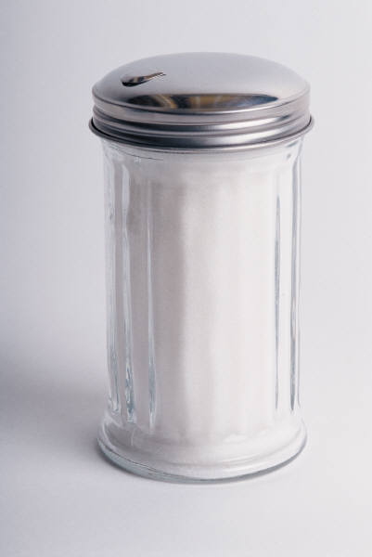
The chlorophyll processes the ingredients to make sugar (plant food) and oxygen.
O₂
Sugar + O2

Slide 7
Respiration Vocabulary
Respiration- The process by which the chemical energy of "food" molecules is released and changed into ATP.
Mitochondria- Rod-shaped organelles with a double membrane which converts the energy stored in glucose into ATP for the cell.

Slide 8
Cellular Respiration Equation
O2 + C₆H₁₂O₆ → H20 + CO2 + ATP
Oxygen + glucose → water + carbon + energy
(sugar) dioxide
Do you notice something about this equation?

Slide 9
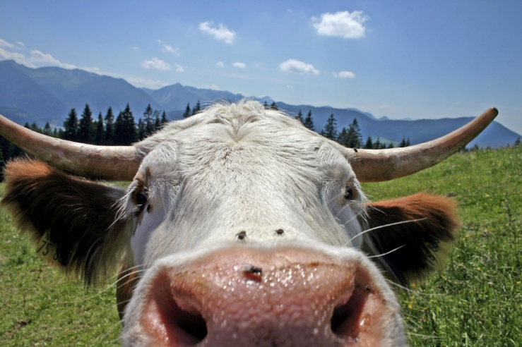
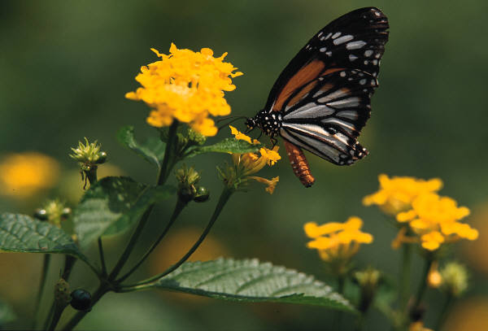
Animals & Plants Rely On Each Other
Animals use:
  Sugar (from producers/plants)
  Oxygen (from producers/plants)
Plants use:
  Carbon dioxide (from animals)

Slide 10
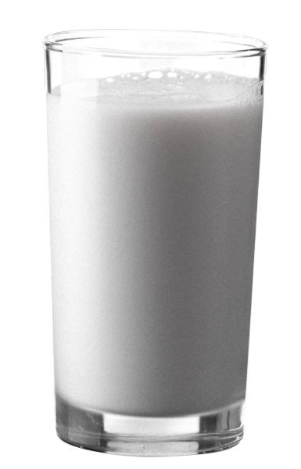
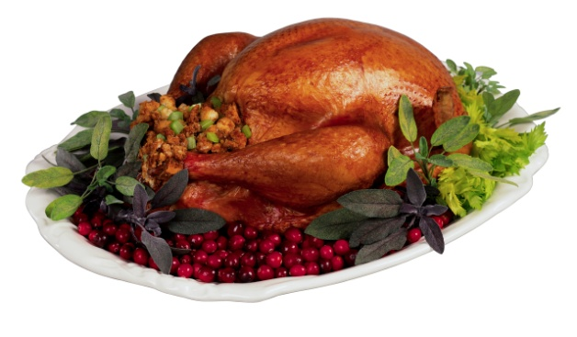
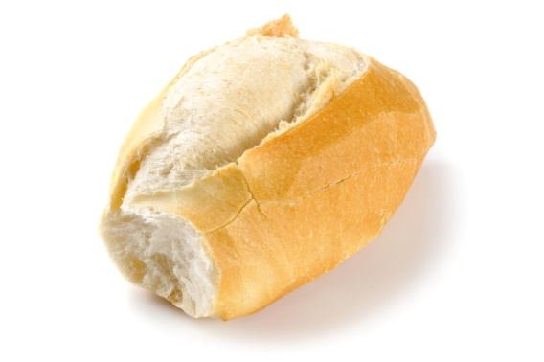
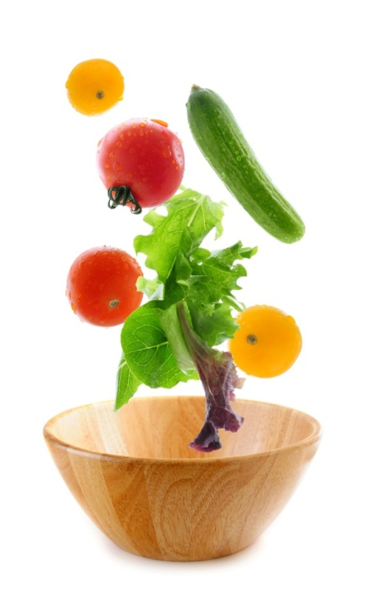
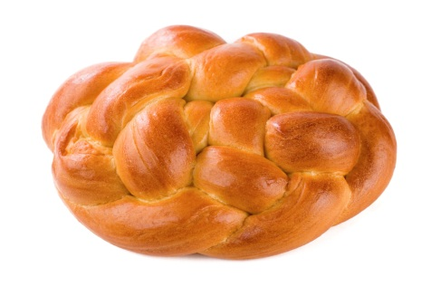
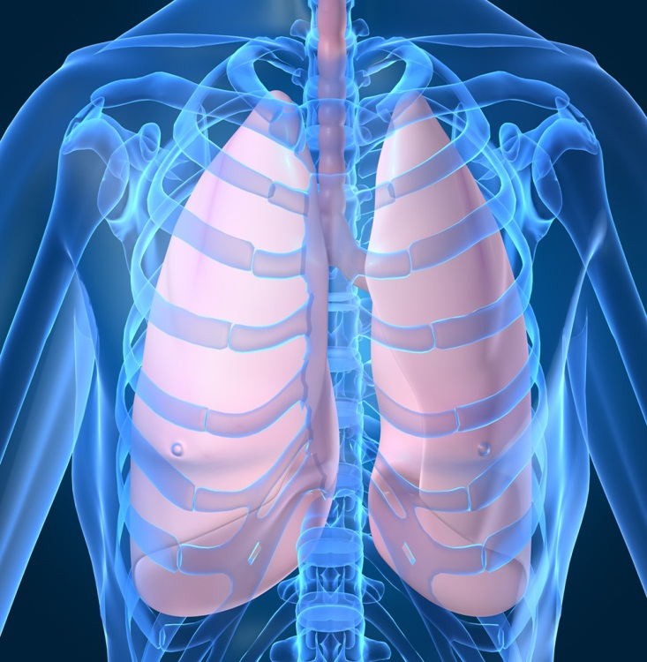
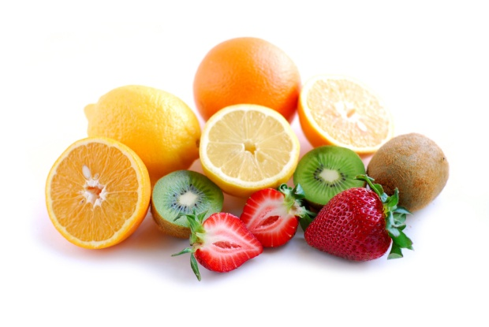
The mitochondria change the O2 and sugars (food)
O2
O2
O2
O2
O2

Slide 11
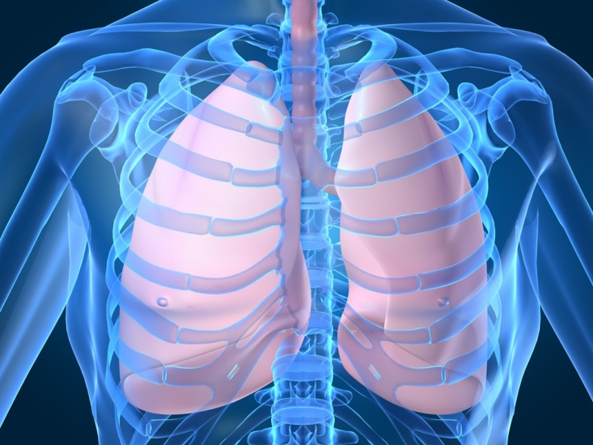
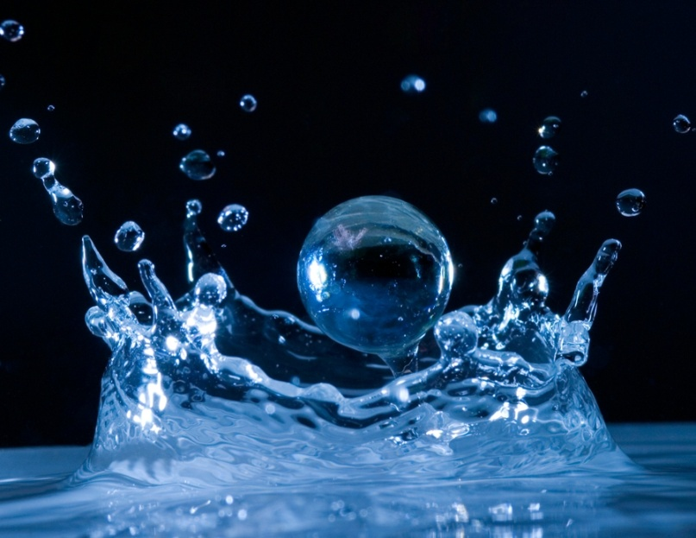
Into CO2, H2O, and ATP
ATP

Slide 12
Comparing Equations
Photosynthesis Equation:
H2O + CO2 + light → O2 + glucose
Respiration Equation:
O2 + glucose → H2O + CO2 + ATP
They are opposites of each other!

