Slide 1
Physical and Chemical Properties/Changes

Slide 2
Properties of Matter
There are properties that are used to describe matter.
Physical Property
can be observed without changing the identity of the substance
Density
Solubility
Malleability
Ductility
Conductivity
Change in State
More:
color
texture
viscosity
mass
volume
luster
Chemical Property
describes the ability of a substance to undergo changes in identity
A new substance is produced
Reactivity
Combustibility
Flammability
More:
toxicity
pH
tarnishing
fermenting
Oxidation

Slide 3
Properties
Examples:
change in state
reactivity
density
solubility
combustibility
physical
chemical
physical
physical
chemical

Slide 4
Matter’s Changes
Physical Change
properties remain the same
changes the form of a substance without changing its identity
All changes in state! (freeze, melt, condense, evaporate, and sublimate)
Examples:
Boil, dissolve, break, split, crack, grind, cut, crush, and bend.

Slide 5
Matter’s Changes
Chemical Change
changes the identity of a substance
a new substance is produced
Examples:
rust, rot, burn, decompose, corrode, oxidize, ferment, and explode!
Evidence of a chemical change:
change in color or odor, formation of a gas, formation of a precipitate (solid), change in light or heat

Slide 6
Matter’s Changes
A physical change during digestion is the mechanical breaking up of food by teeth.
A chemical change during digestion is the chemical breaking down of food in the mouth, stomach and small intestine with the aide of enzymes.

Slide 7
Matter’s Changes
Examples:
rusting iron
dissolving in water
burning a log
melting wax
grinding spices
chemical
physical
chemical
physical
physical

Slide 8
Chemical and Physical Properties/Changes
Quizizz: 037800

Slide 9
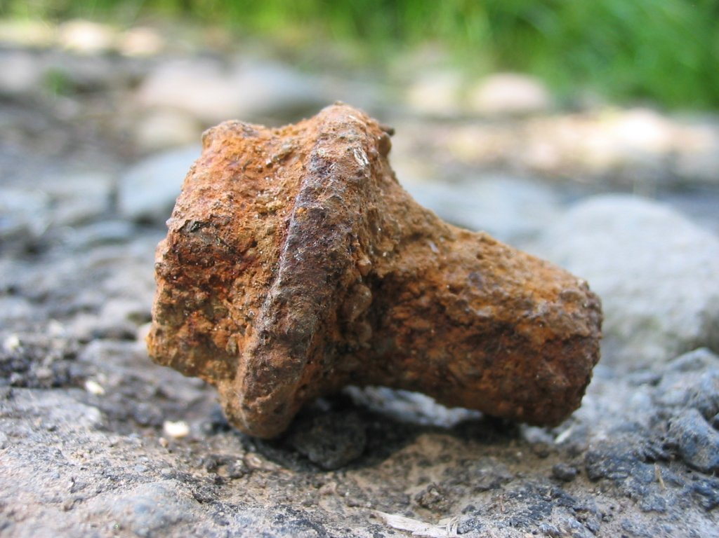
Physical & Chemical Changes Game
Chemical

Slide 10
Physical & Chemical Changes Game
Physical

Slide 11
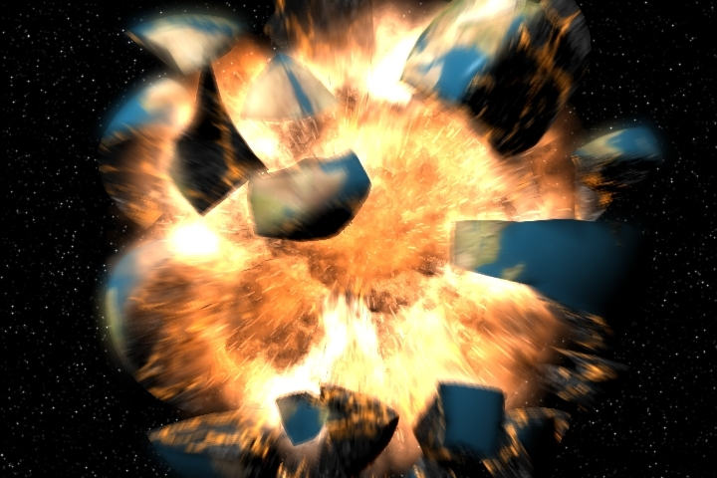
Physical & Chemical Changes Game
Chemical

Slide 12
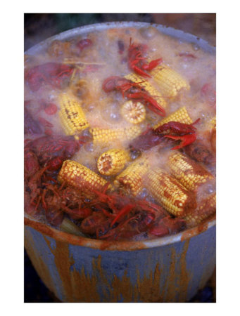
Physical & Chemical Changes Game
Physical

Slide 13
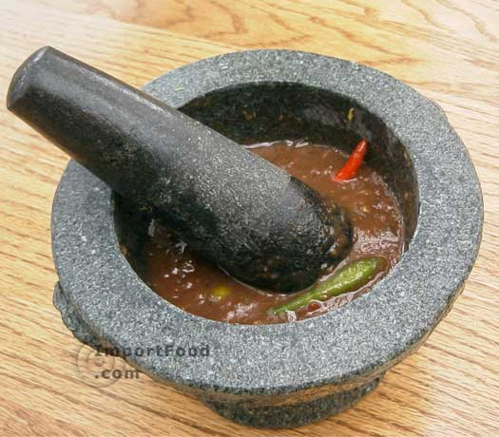
Physical & Chemical Changes Game
Physical

Slide 14
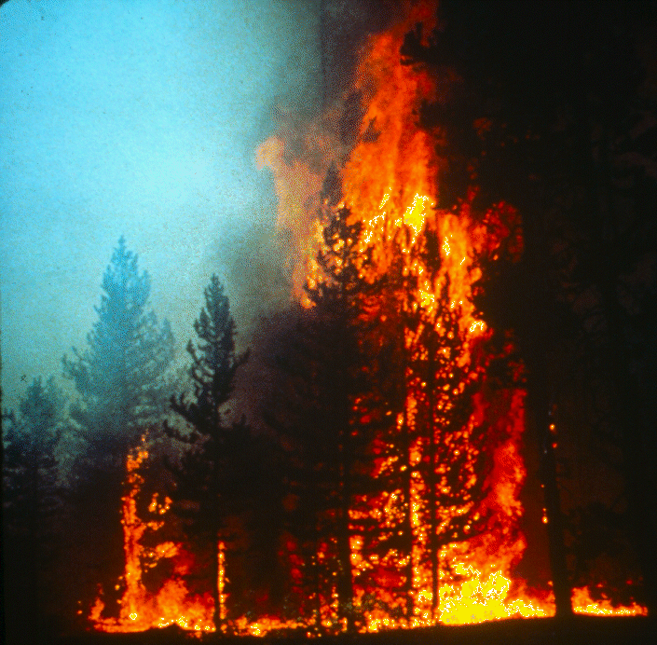
Physical & Chemical Changes Game
Chemical

Slide 15
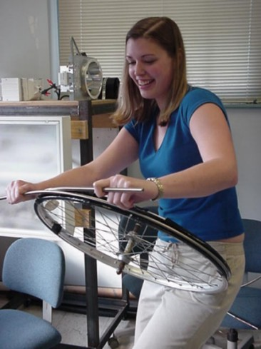
Physical & Chemical Changes Game
Physical

Slide 16
Physical & Chemical Changes Card Game
Physical

Slide 17
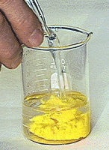
Physical & Chemical Changes Game
Chemical

Slide 18
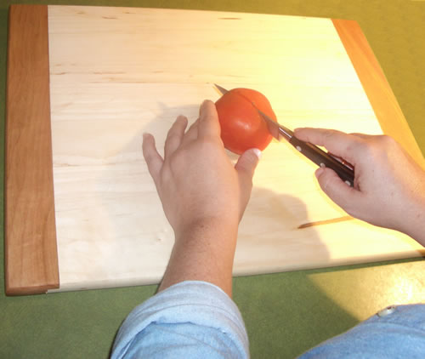
Physical & Chemical Changes Game
Physical

Slide 19
Physical & Chemical Changes Game
Physical

Slide 20
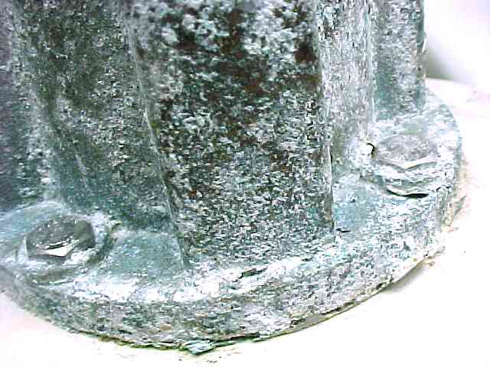
Physical & Chemical Changes Game
Chemical

Slide 21
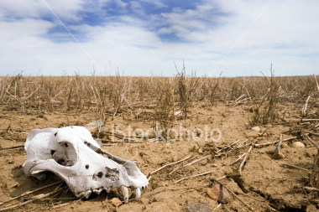
Physical & Chemical Changes Game
Chemical

Slide 22
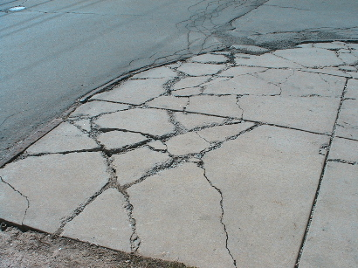
Physical & Chemical Changes Game
Physical

Slide 23
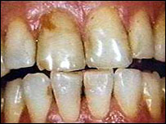
Physical & Chemical Changes Game
Chemical

Slide 24
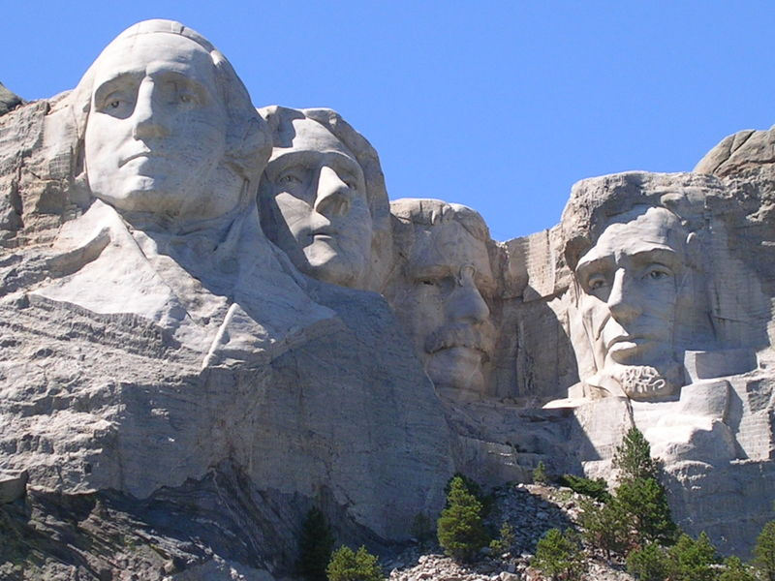
Physical & Chemical Changes Game
Physical

Slide 25
Learning Check
Which of the following changes involved in manufacturing an automobile is a chemical change?
a. applying paint to the body of the automobile
b. making plastics from petroleum products
c. making steel from iron, carbon, and other metals
d. rolling out steel into sheets
Notes:
Answer b

Slide 26
Learning Check
Which of the following is a physical change?
a. aluminum oxidizing
b. an acid and a base forming a salt and water
c. ice cream melting
d. paper burning
Notes:
Answer c

Slide 27
Learning Check
In the rock cycle, which of these is a chemical
change involved with the formation of igneous
rocks?
F Compression of sediments
G Heat loss from lava
H Subduction of plates
J Formation of minerals
Notes:
Answer J

